Slide 1
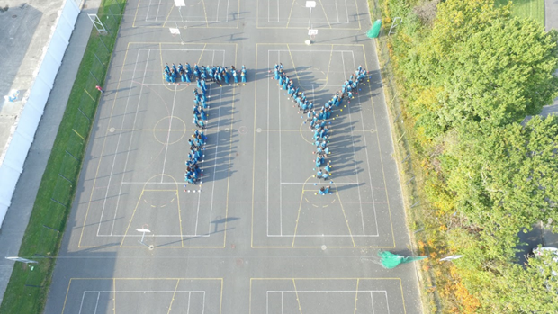
Transition Year Programme
Transition Year Programme
Mr.Tomas Quealy
T.Y. Co-ordinator
Tom.Quealy@stcaimins.ie

Slide 2
Transition Year Programme
Summary:
Philosophy of Transition Year.
Benefits and concerns.
Student Approaches
Role of parents
Assessments / Journal.
Subjects.
Admissions Policy and Costs.
Workshops
Work Experience
Business.
Programmes.
Careers.
Physical Education.
Other Activities.
Questions

Slide 3
Transition Year Programme
The Transition Year (TY) is a one-year programme designed to act as a bridge between the Junior Certificate and Leaving Certificate programmes.
Each school designs its own Transition Year programme, within set guidelines, to suit the needs and interests of its students.
The school promotes the personal, social, vocational and educational development of students.

Slide 4
Transition Year Programme
Benefits
ESRI & NCCA report: TY students get Higher points average in LC. (26/5)
“Increased Maturity”
Informed choices.
Broaden skills Set.
Experience.
Teamwork.
Concerns
Not for everyone.
A lot of the onus on student participation.
Reduced homework.
Different base classes or separated from friends.

Slide 5
Transition Year Programme
Be Open Minded
Role
of T.Y. Student
Have-a-go
Positive Attitude
Respect Others

Slide 6
Transition Year Programme
Application Form
Role
of Parents
Encourage
Support
Communicate

Slide 7
Transition Year Programme
Assessment
Students undertake continuous assessment including…
Group work, Presentations, written exam, etc
Participation in class, project work, social work, group work, work experience etc.
Subject Reports sent home at Christmas & Summer
End of year interview & student showcase
Journals
Reflective log.
Review Class-twice weekly.
Useful in assessing the level of student participation/attendance in Transition Year.

Slide 8
Transition Year Programme
Core Subject
Mathematics
English
Gaeilge.
Religious Education.
MFL
Weekly Subjects
Information and Communications Technology
Physical Education
Gaisce/Personal Reflection
Guidance
Enterprise

Slide 9
Transition Year Programme
Subject to Change.
Subject Sampling | TY Specific | Calendar Layer
Business/Enterprise | Mini-Company | Work Experience
Career Guidance | Public Access to Law | Gaisce
History | Music Generation Clare | Outdoor Pursuits
European Studies | First Aid | Jnr. Achievement
Personal Development | Film and Radio Studies | Visiting speakers
 | Digital Photography | Workshops
 | Driver Education

Slide 10
Transition Year Programme
The admissions criteria includes the following.
Students get an opportunity on the application form & at interview to state why they wish to do TY.
Suitability of Student for the programme is decided by the school management as outlined in the transition year enrolment policy.
Possible to run 2 classes of 24 students.
A shortlist will be created for any remaining applicants.

Slide 11
Transition Year Programme
Application Process.
Tick the TY box on the options form.
Complete the TY application form. This form must be completed by both the parent/guardian and the student.
Student completes an interview
A letter confirming the status of your application will be sent to all applicants.
Pay initial deposit

Slide 12
Transition Year Programme
Transition Year Fee Per Student: €400
Initial deposit of €200 due with acceptance of place on the course.
The balance of €200 is due before 1st September 2023
What does the fee cover?
Outdoor Education activities
First Aid Qualification
Industry Visits
Guest Speakers
Transport costs
ICDL Course
Driving Theory Qualification.
Most TY activities
Programmes
Workshops
Student Services

Slide 13
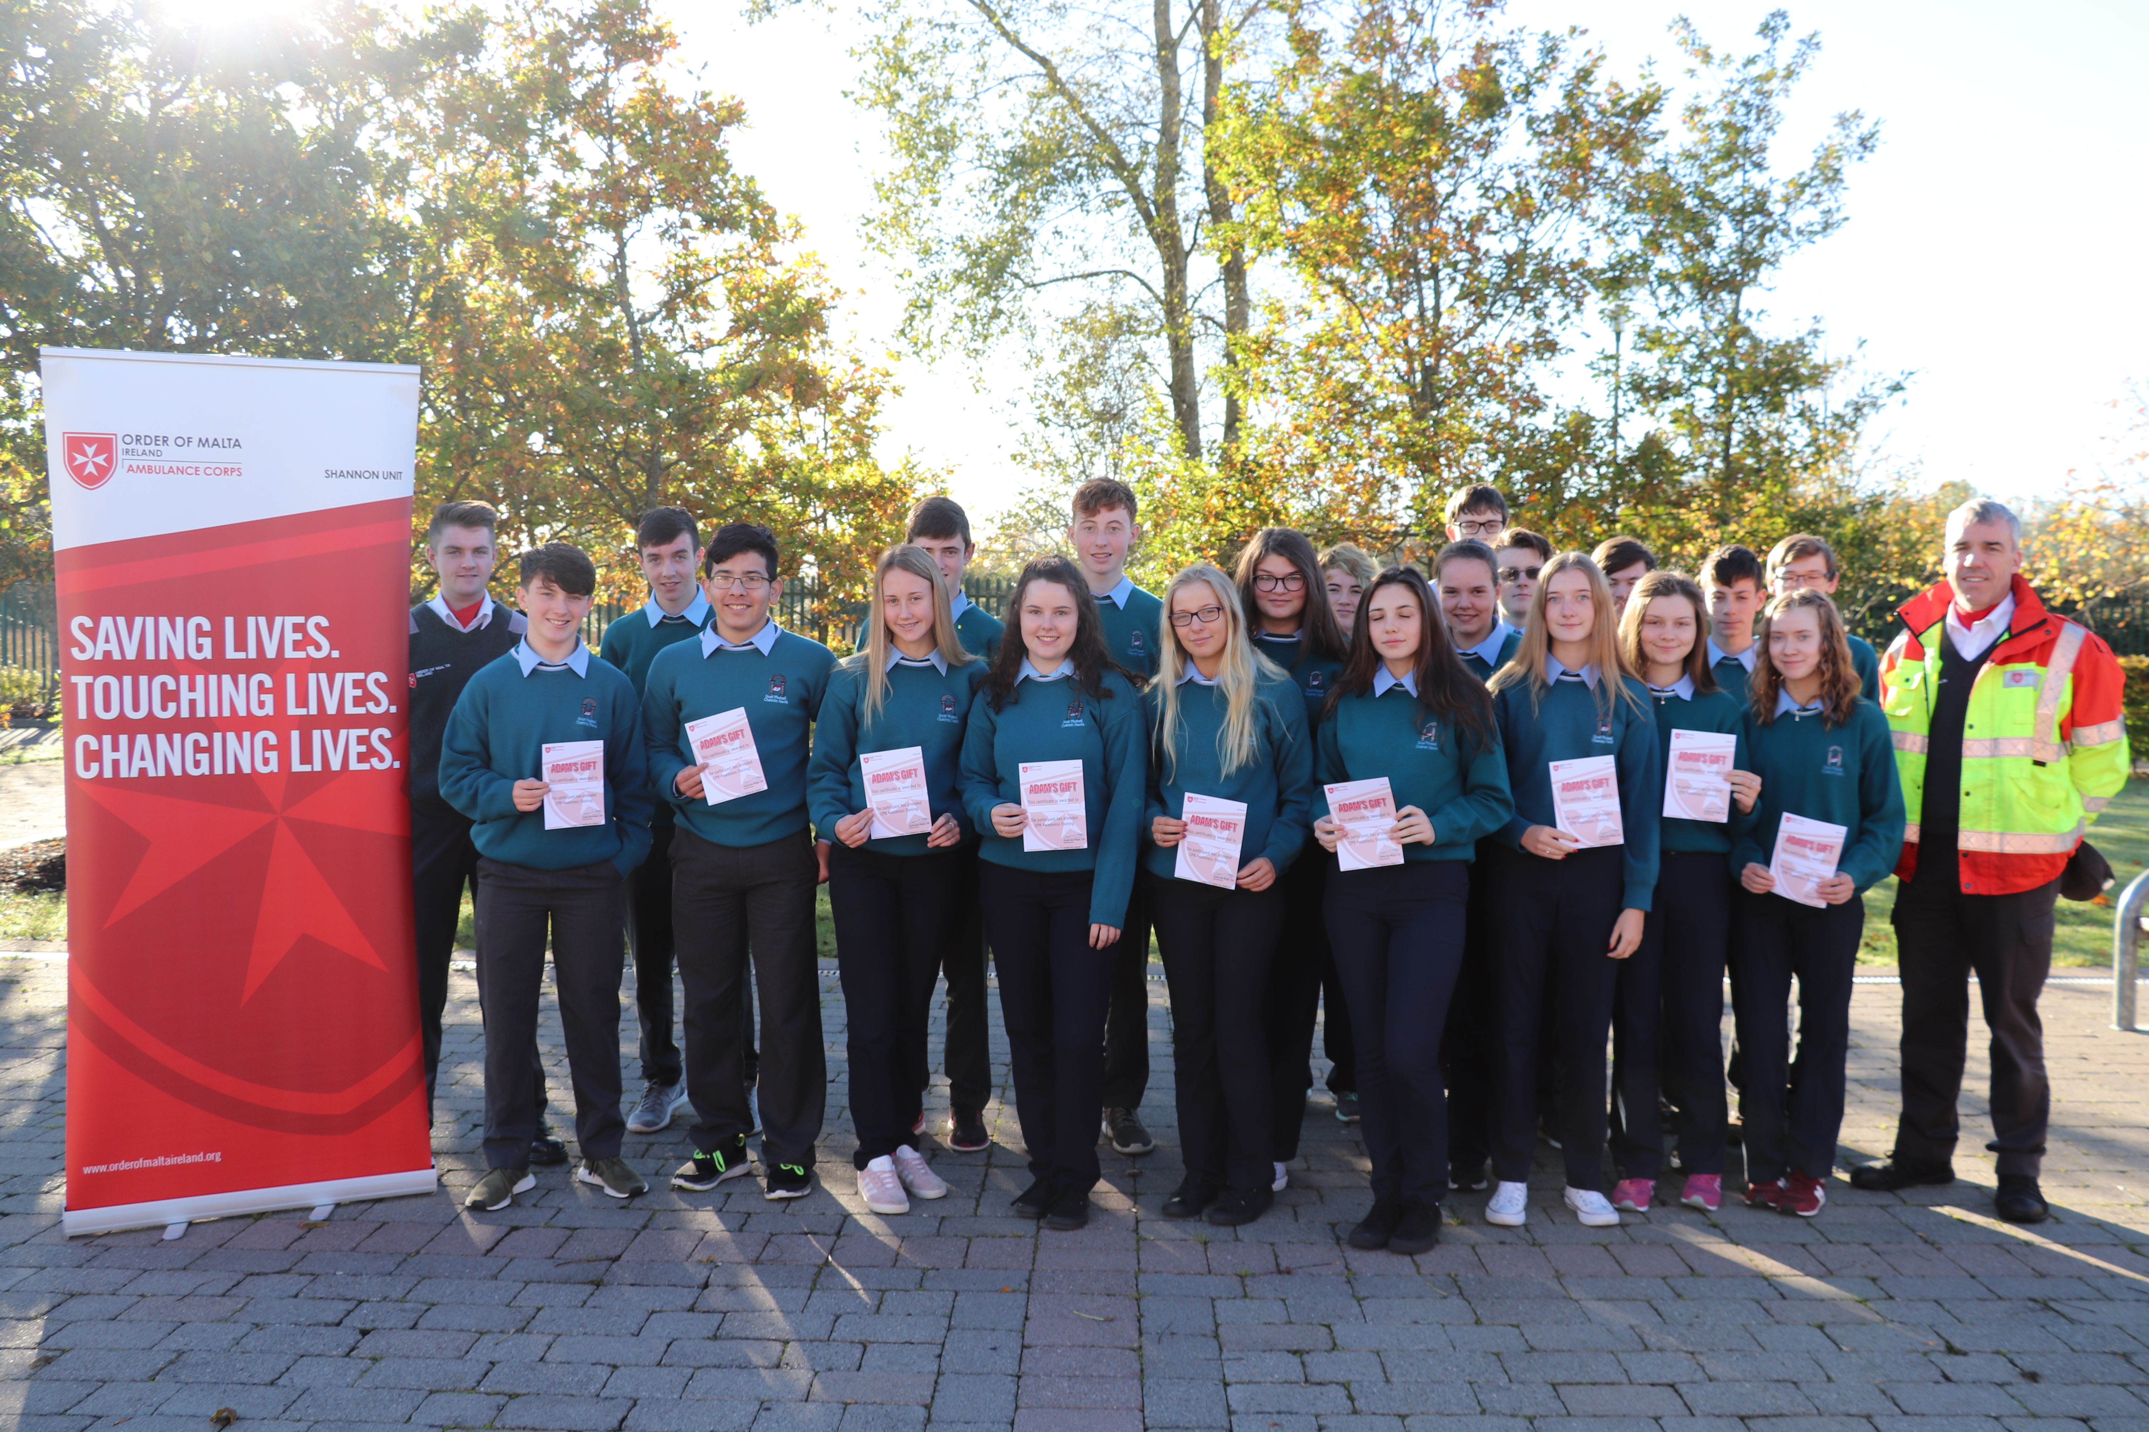
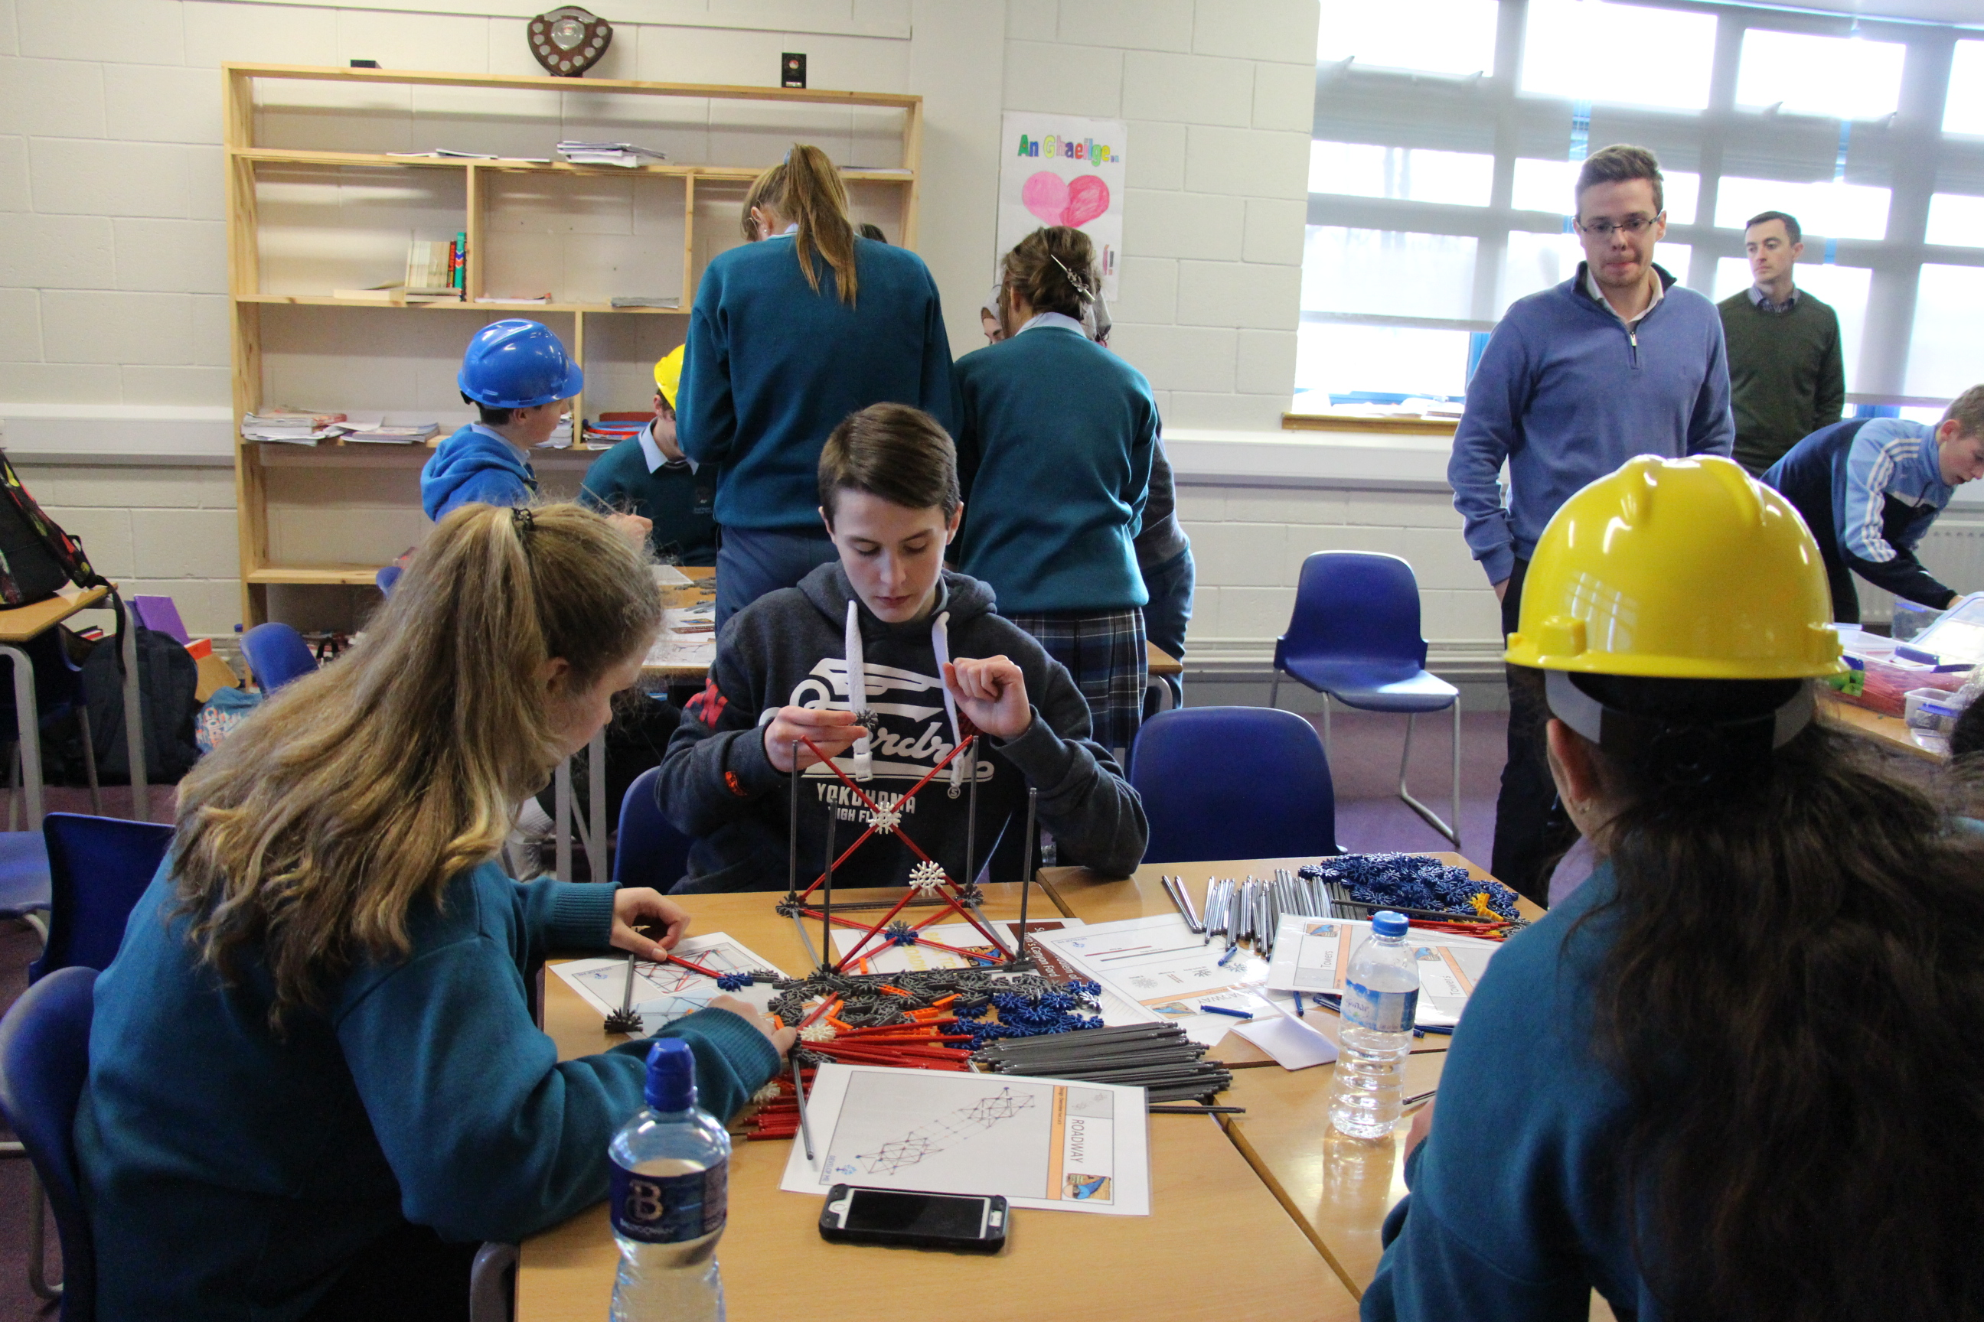
Transition Year Programme
Sign Language
Personal Development
Animal Magic
Workshops
Music
Radio/Film
Road Safety

Slide 14
Transition Year Programme
Work Experience will take place every Friday
3-4 Rotations
Find Placement
Week Option
Work Experience
Reflection
Garda Vetting
Insurance

Slide 15
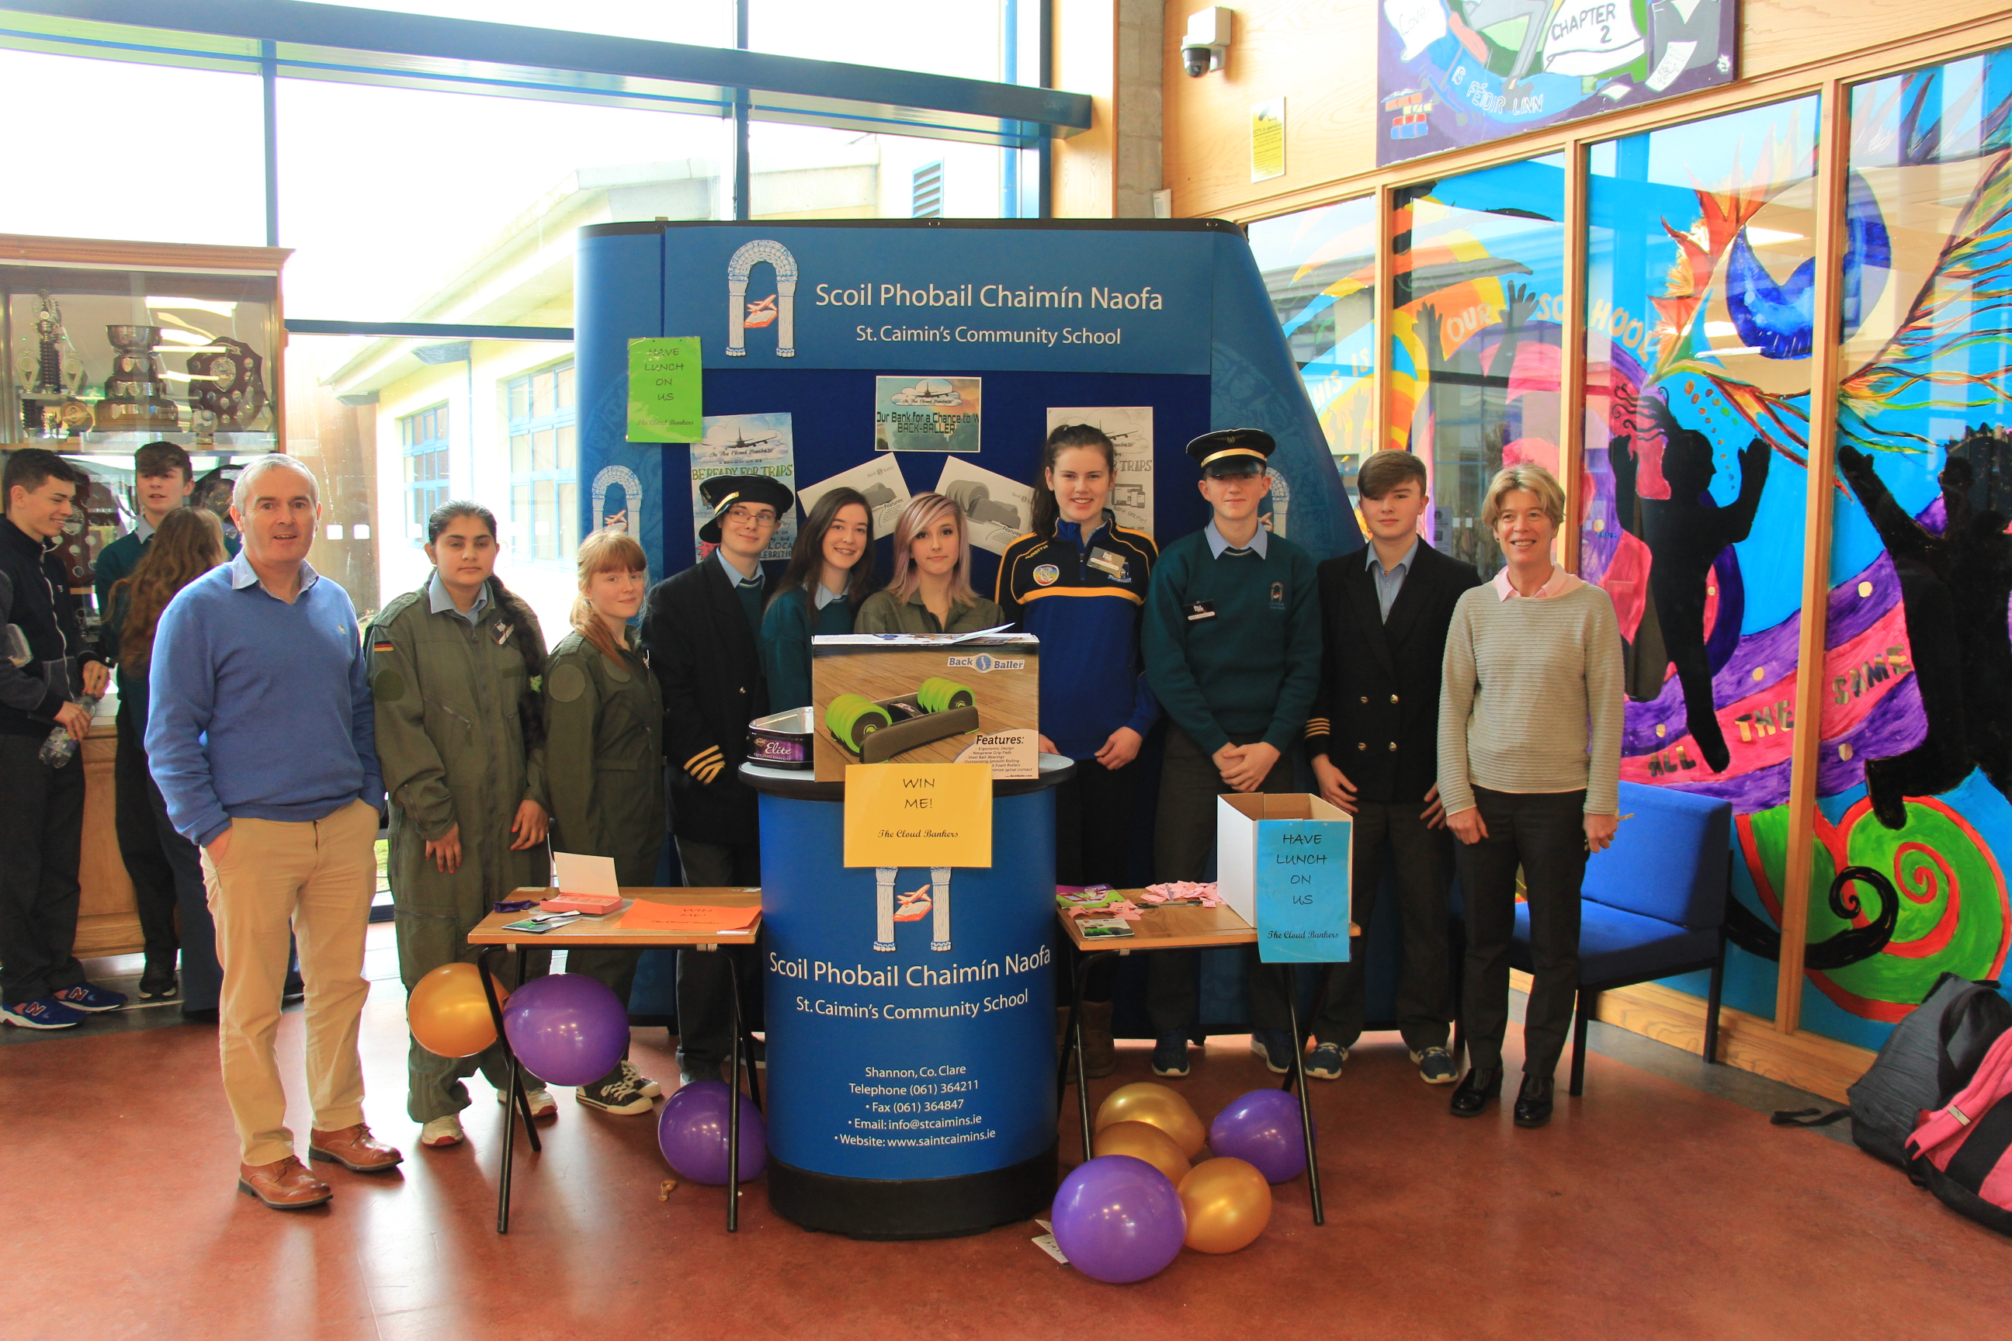
Transition Year Programme
Industry Visits
Christmas Market
School Bank
Business
Event Management Project
Mentoring
Visiting Speakers

Slide 16
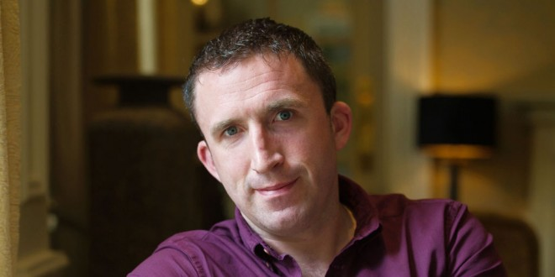
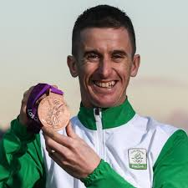
Transition Year Programme
Inspirational Speakers
Tomas Mac Conmara
Local Historian
Rob Heffernan
Olympic Athlete BOI Ambassador

Slide 17
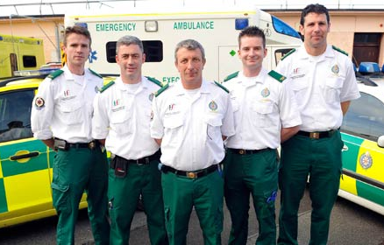
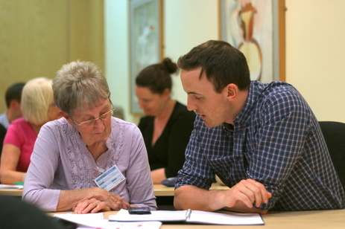
Transition Year Programme
Future Leaders
First Aid
ICDL
Programmes
Gaisce
Accountancy Bootcamp
Junior Achievement

Slide 18
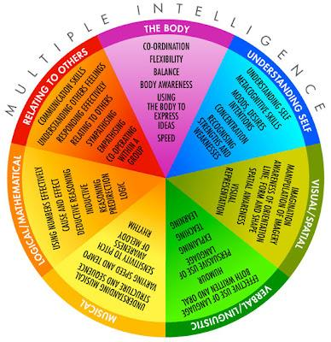
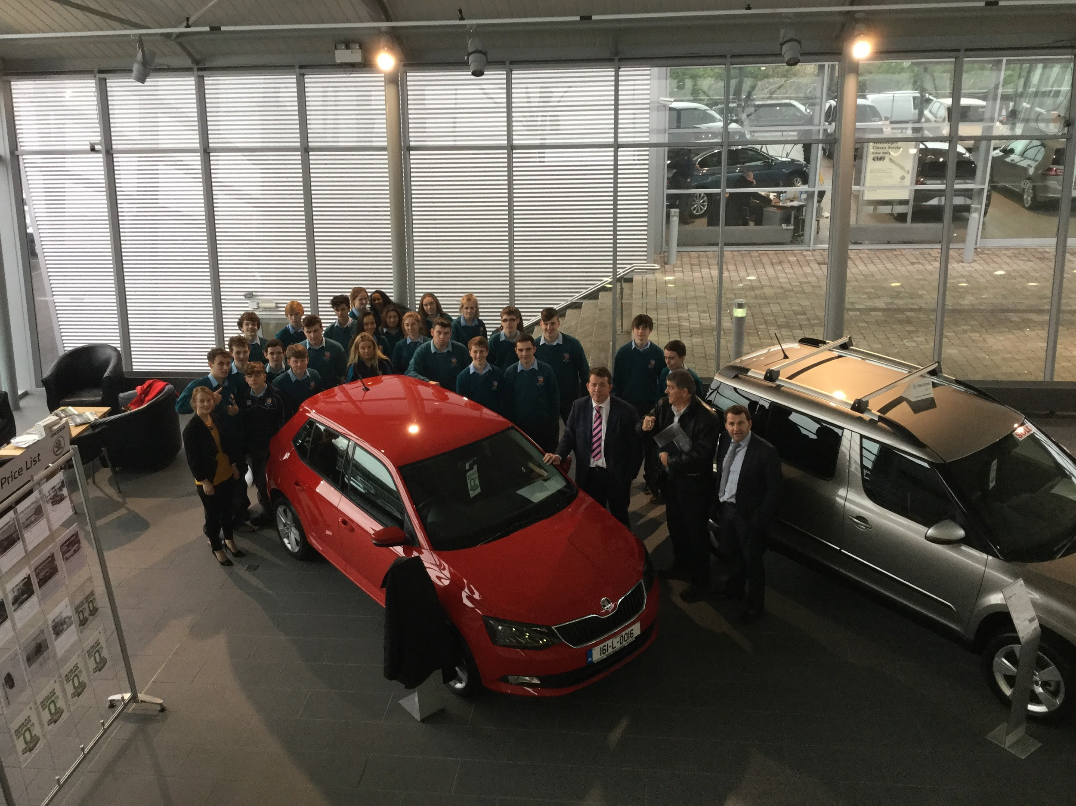
Transition Year Programme
Eirquest
Testing
Subject Option Fair
Guidance Class
Careers
Irish Hotel Federation Hospitality Course
Work Experience
Visiting Speakers

Slide 19
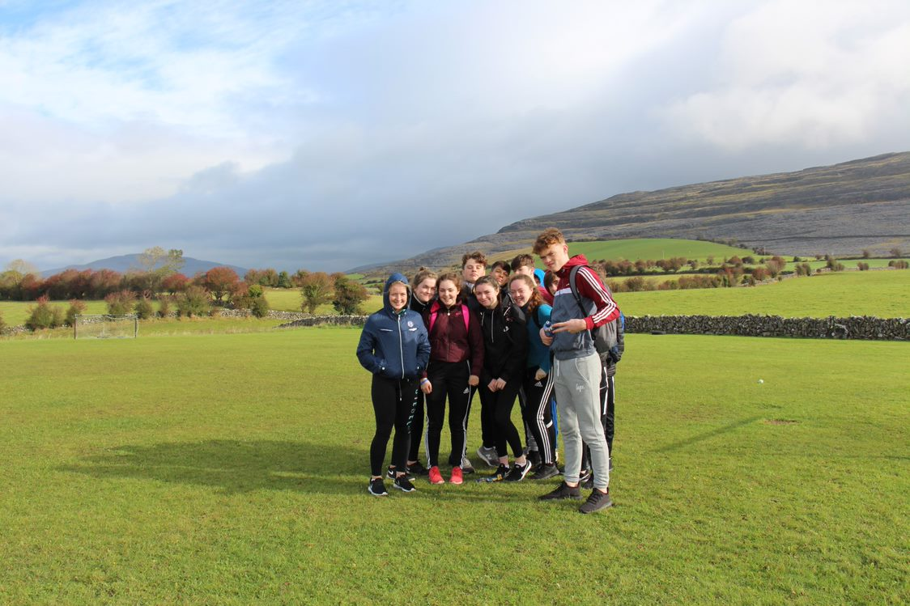
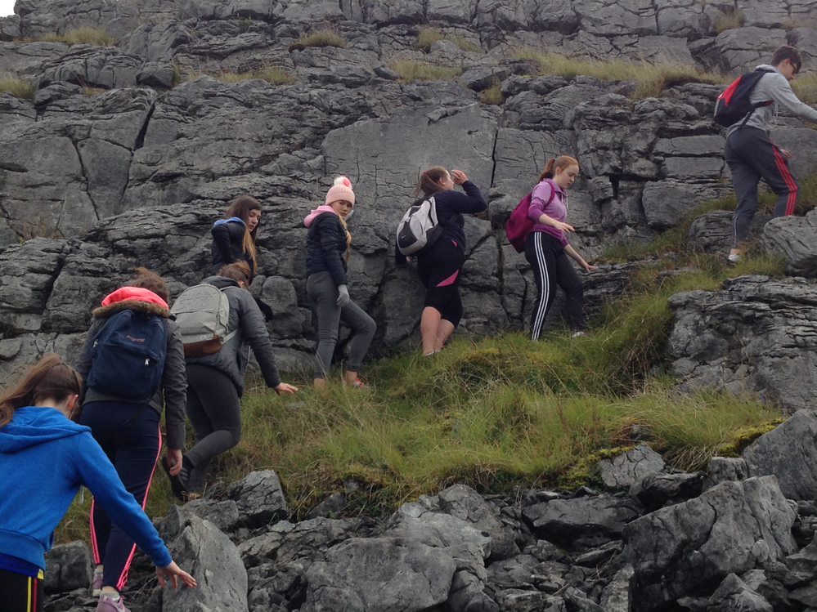
Transition Year Programme
Coaching
Fencing Lessons
Mini Marathon
Physical Education
Burren or Derg Is. Outdoor ed. Centre
Ice Skating
Surfing

Slide 20
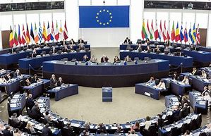
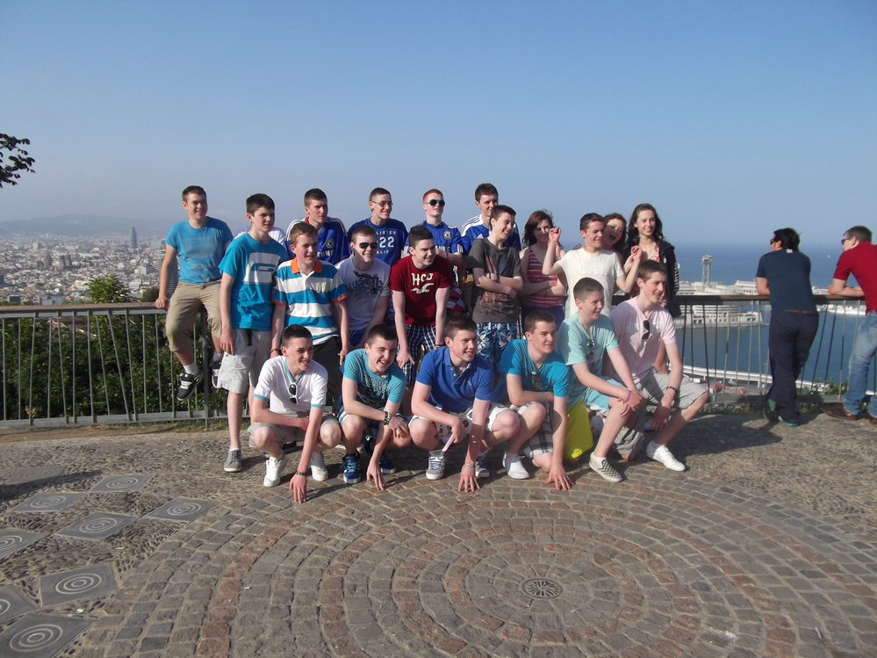
Transition Year Programme
European Parliament Ambassador School
French Exchange option
Naples Tour option
International Experience

Slide 21
Transition Year Programme
A sample of the many other activities offered to students in Transition Year.
Future Leaders | Music Generation Clare | Ice Skating | Mentoring 1st Year students
Get Go, Get Rowing | Royal College of Surgeons taster days | Animal Magic | Irish Heart Foundation
History Trip | Public Access to Law | Clare Sports Partnership | Dance Lessons
Fencing Lessons | Teen Conflict Management | IT for Senior Citizens Group | GAA Coaching Course
Bodhran-making course | Radio workshop | Shannon Foynes Competition | E-Scooter Training
Road Safety | EU Language Competition | EU Parliament Competition | Debating
RSA Roadshow | CPR | Burning House Film Course | Photography workshop

Slide 22
Transition Year Programme
E-Portfolios
Students complete an E-Portfolio using Microsoft Teams
Students will be trained on developing their reflective skills and encouraged to apply this to their learning in all subject areas.
In May students' showcase their portfolio and complete an interview based on the Portfolio

Slide 23
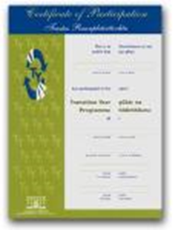
Transition Year Programme
Certification
Students will earn credits in their subjects, E-Portfolio, community involvement, extra-curricular and from their end of year presentation/formal interview.
The following standards will apply for certification
Distinction 80-100%
Merit 60-79%
Participation Below 60%

Slide 24
Transition Year Programme
Míle Buíochas
Contact: Tom.Quealy@stcaimins.ie
Tel: 061 364211

Slide 25
Application Process

Slide 26
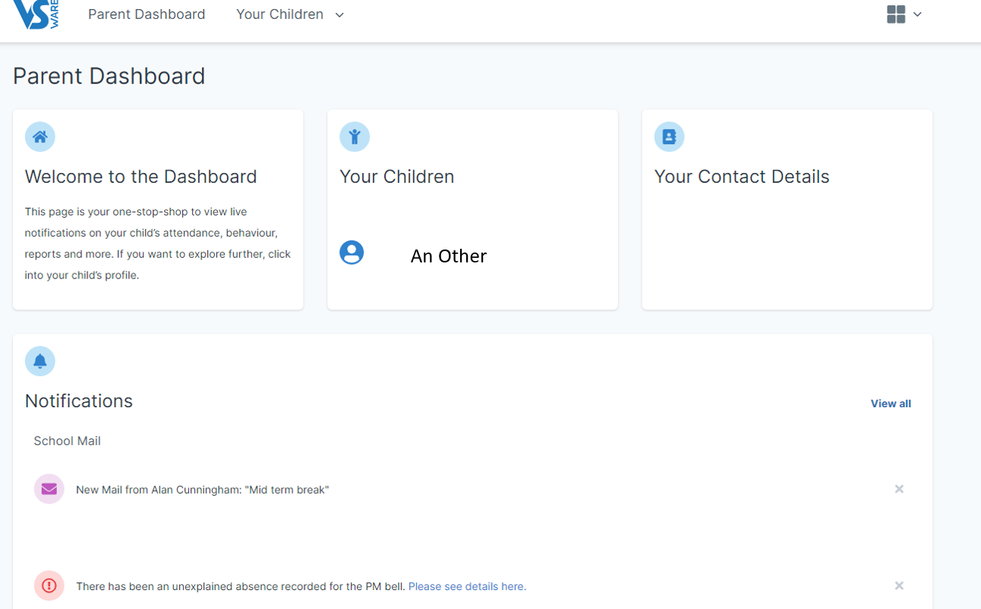

Slide 27
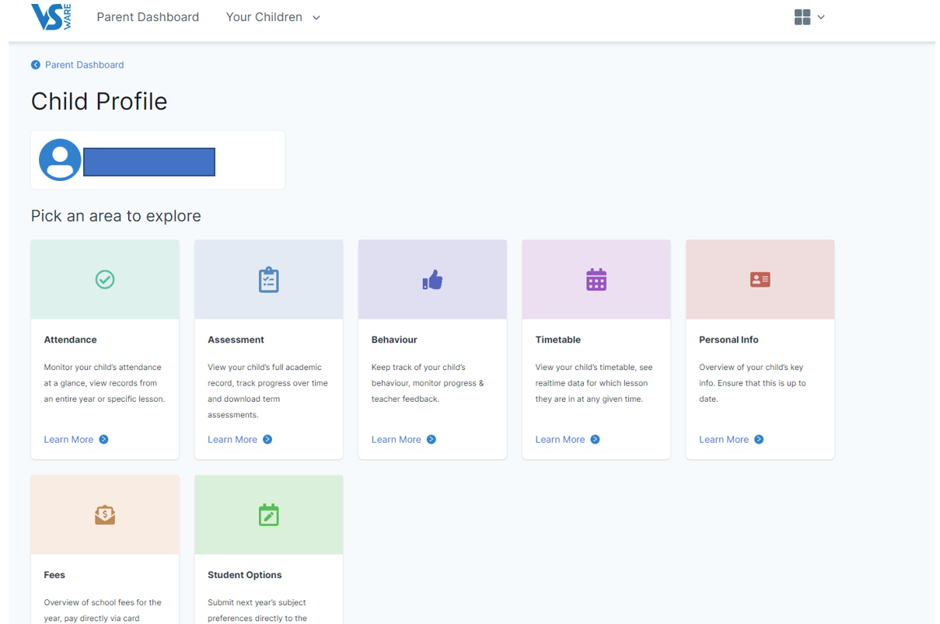

Slide 28
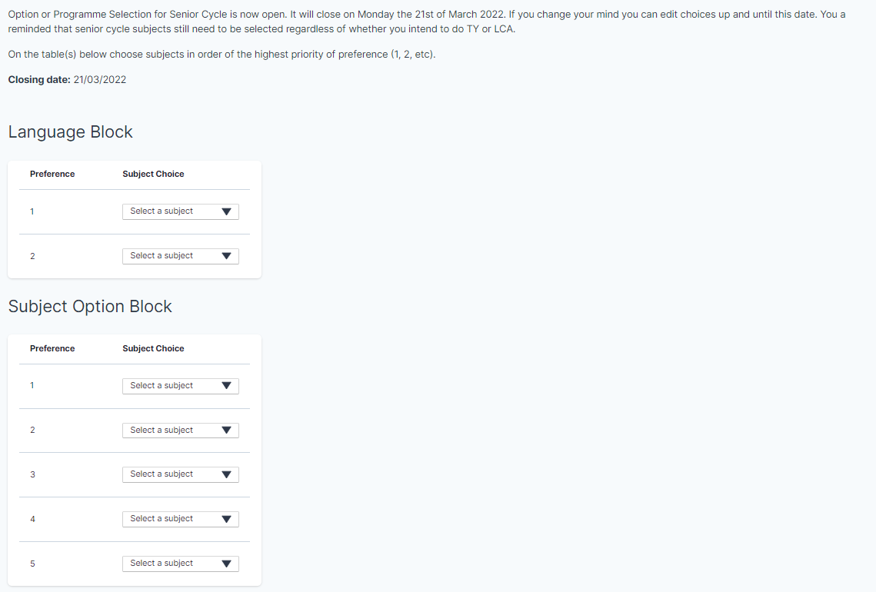

Slide 29
