Slide 1
What is the Leaving Certificate Applied?
It is a distinct, self-contained two-year Leaving Certificate programme aimed at preparing learners for adult and working life.
It emphasises forms of achievement and excellence which the established Leaving Certificate has not recognised in the past.
It offers learners specific opportunity to prepare for and progress to further education and training.

Slide 2
Who would benefit most from the Leaving Certificate Applied?
Learners who are not adequately catered for by other Leaving Certificate programmes.
Learners who choose not to opt for those programmes.

Slide 3
Rationale for LCA
Prepares learners for the demanding transition to adult and working life.
Recognises talents of all learners - programme responsive to aptitudes, abilities, needs and interests.
Provides opportunity to develop in terms of responsibility, self-esteem and self-knowledge.
Develops communication and decision making skills.
Helps learners achieve a more independent and enterprising approach to learning and to life.

Slide 4
Key Underlying Principles
student centred curriculum
personal and social development
integration and cross curricular links
team work
literacy & numeracy development
active teaching/learning methodologies
reflection
community links

Slide 5
LCA Curriculum
Vocational Preparation | Vocational Preparation & Guidance English & Communications
Vocational Education | Mathematical Applications Vocational Specialisms* (Choose 2 from 11 options) Information Communication Technology
General Education | Arts Education (Dance, Drama, Music, Visual Arts) Social Education Languages (Gaeilge and French/Italian/German/Spanish) Leisure & Recreation (including Physical Education) Religious Education Science

Slide 6
Vocational Specialisms
www.pdst.ie/lca/moduledescriptors
Engineering
Technology
Childcare/Community Care
Graphics and Construction Studies
Craft and Design
Agriculture/Horticulture
Hotel Catering and Tourism
Hair and Beauty
Office Administration and Customer Care
Active Leisure Studies
Information and Communications Technology
Choose
2
From
11
Options

Slide 7
LCA Modes of Assessment
Satisfactory completion of modules + 90% attendance Evidence of completion of 4 key assignments for each module One credit per course module in which there is a final exam Two credits per course module in which there is NO final exam | 62 credits | 31%
7 Student tasks @ 10 credits each | 70 credits | 35%
Final examinations | 68 credits | 34%
Total | 200 credits | 100%
Vocational Preparation | Vocational Education (x2) | General Education
Contemporary Issue | Personal Reflection | Practical Achievement
English & Communication | Vocational Specialisms (x2) | Languages (x2) | Social Education | Mathematical Applications
12 credits | 12 credits each | 6 credits each | 10 credits | 10 credits

Slide 8
Summary of Tasks
Task | Credit | % | Completed in session | Assessed
General Education Originating in Arts Education, Leisure & Recreation, Language or Social Education | 10 | 5 | 1 | Jan/Yr 1
2. Vocational Preparation Originating in either Vocational Preparation & Guidance or English & Communication | 10 | 5 | 2 | May/Yr 1
3. Vocational Education - 1st specialism Originating in one Vocational Specialism | 10 | 5 | 2 | May/Yr 1
4. Vocational Education - 2nd specialism Originating in the second Vocational Specialism | 10 | 5 | 3 | Jan/Yr 2
5. Contemporary Issues Anchored in Social Education | 10 | 5 | 3 | Jan/Yr 2
6. Practical Achievement Generally out of school/centre | 10 | 5 | 3 | Jan/Yr 2
7. Personal Reflection Statement 1 from year one will be stored and returned to SEC when statement two is complete | 10 | 5 | on-going | May/Yr 2

Slide 9
Opening up New Options
The Leaving Certificate Applied Route Map
Leaving Certificate Applied
(QQI Level 4)
Vocational Preparation
Vocational Education
General Education
Further Education
Post Leaving
Certificate
Course
(QQI Level 5 & 6)
Further & Higher Education
(QQI Level 7 & 10)
Careers
SOLAS
Apprenticeships

Slide 10
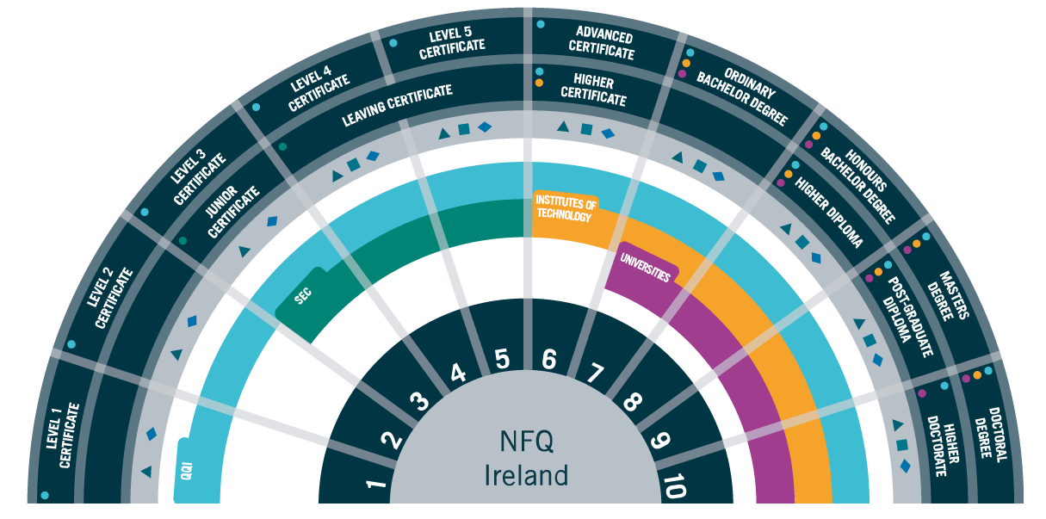
Irish National Framework of Qualifications (NFQ)

