Slide 1
CAO 2021:
Third Level Applications

Slide 2


Slide 3
Choosing Courses Research:
Research each course carefully from prospectus , websites and visiting college etc.
Consult with Guidance Counsellor
Discuss with family and friends
Websites: Qualifax.ie , careersportal.ie, steps.ie, college websites etc.

Slide 4
Topics will look at tonight:
The CAO Application
HEAR and DARE applications
Apprenticeships
PLC Applications
Other alternatives

Slide 5
What is the CAO?
CAO stands for Central Application Office
Never apply directly to college for a course – all done through a central system

Slide 6
CAO Application:
7 Universities
14 Institutes of Technology
Colleges eg. Mary I, Shannon College
Private Colleges eg. Independent colleges, Griffith Colleges

Slide 7
How to Apply:
CAO Applications can be opened online on www.cao.ie since Monday 5th of November
The first time student’s apply they will receive a CAO number which allows them to log in and out of their CAO account and make changes to their CAO as many times as you wish until 1st of Feb
CAO number is different to the Exam Number students will receive from the school

Slide 8
Timetable of CAO Events 2019/2020:
November 5th | CAO online Application Facility opens
January 20th | Apply online by this date ,avail of discount price of 30 euro. Free change of mind until Jan 31st
Feb 1 | Closing date up until 5.15pm Cost 45 euro NB must have Restricted Courses in Application
Feb 22nd | HPAT 2020
March/April | Tests and auditions for restricted courses

Slide 9
Continued CAO Dates:
May 5th | Change of Mind facility opens
July 1st 5.15pm | Change of mind online facility closes –students final course choices made by this date.
Mid August TBC | Leaving Cert results are issued – example Tues 13th in 2019
TBC | Round 1 offers are issued (example 2019 it was 2 days after results on 15th of August)
TBC | offers must be accepted (example)2019 it was 22nd August)
TBC | Round 2 offers [opportunity to view scripts: Early September]

Slide 10
Continued CAO Dates:
Early September | HEI’s registration begins
Early October | Results of LC Appeals released……
TBC | Offer season ends
10

Slide 11
4 Important things to understand when applying to the CAO:
1. Matriculation and course requirements
2. Points system
3. Levels of Qualifications
4. Genuine Order of Preference

Slide 12
First thing to understand..
1.Matriculation

Slide 13
Matriculation:
To matriculate for a college means to have the basic requirements for entry.
It has nothing to do with points.
According to the CAO on average over 2,000 students waste course choices as they do not matriculate for courses they applied to.
Notes:
13

Slide 14
Basic College Matriculation:
2018 Matriculation Requirements: | Pre-2018 Matric Requirements:
Level 8 degrees: 2H5 and 4 O6/H7 grades | 2HD1 and 4 OD3
Level 6 and 7: 5 O6/H7 grades | 5 OD3

Slide 15
General Matriculation Guidelines (some course have more specific requirements):
UL: Maths, English and ONE other language e.g.Irish OR another language (e.g.French or German)
TCD: Maths, English and ONE other language ( e.g. Irish OR French or German)
DCU: Maths and English OR Irish
NUIs including NUIG,UCD, NUIM and UCC: Maths, English, Irish AND another language (except for Engineering or Science courses)

Slide 16
Matriculation:
Maths, English & Irish - most commonly required.
A 3rd Language is required by the NUI colleges except for Science and Engineering courses
Most Business courses state a requirement in Maths - not a Business subject!
A minimum of one science subject is required for paramedical and Scientific courses eg.Nursing,Physiotherapy,Health and Performance
Notes:
16

Slide 17
Some courses have specific subject requirements:
Some courses require a specific grade in a subject before you are allowed entry to the course – this means even if the student got the required points but not the specific grade they would not be allowed begin the course

Slide 18
Some Examples of Course Requirements:
Biological and Chemical Science UL (03/H7 in Maths and a H4 in a lab science)
Business UL (04/H7 in Maths)
Journalism and New Media UL (H4 in English)
Computing Technologies (H6/O2 Maths)
Commerce with French UCC (H3 in French)
Engineering courses in universities –H4 Maths, 06/H7 in 1 science subject (Maths exam available in some colleges if don’t matric)
Financial Maths and Economics (NUIG 01/H5 in Maths)
Primary Teaching Mary I (H4 in Maths and 04/H7 in Maths and English
Notes:
18

Slide 19
Second thing to understand..
2. Points

Slide 20
The Points System:
Generally in the CAO system
No. of qualified applicants > No. of course places
--> selection system is needed.
Selection system used in Irish 3rd Level Colleges is
POINTS SYSTEM
Points are calculated from ONE sitting of the Leaving Certificate only.
Points total is calculated from SIX best subjects
Entry Requirements can be satisfied over more than one sitting of the Leaving Certificate (unless otherwise stated eg. Medicine)

Slide 21
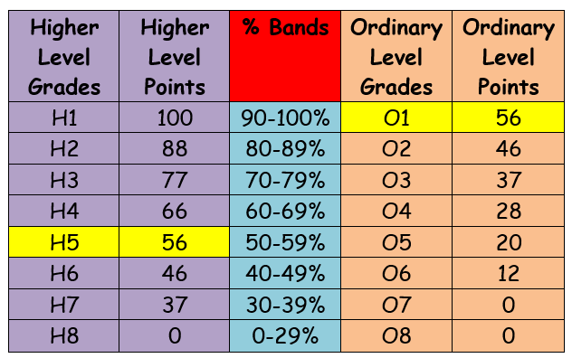
New Points System since 2017:

Slide 22
The Points System:
Points change EVERY year – rise and fall depending on POPULARITY
Courses that are popular will generally have high points
Points have no bearing on the difficulty or the value of any course.
Do not make choices based on predictions of next year's cut off points or their own point scores
Put down what you genuinely want not what you think you will get.

Slide 23
Third thing to understand…
3. Levels of Qualifications

Slide 24
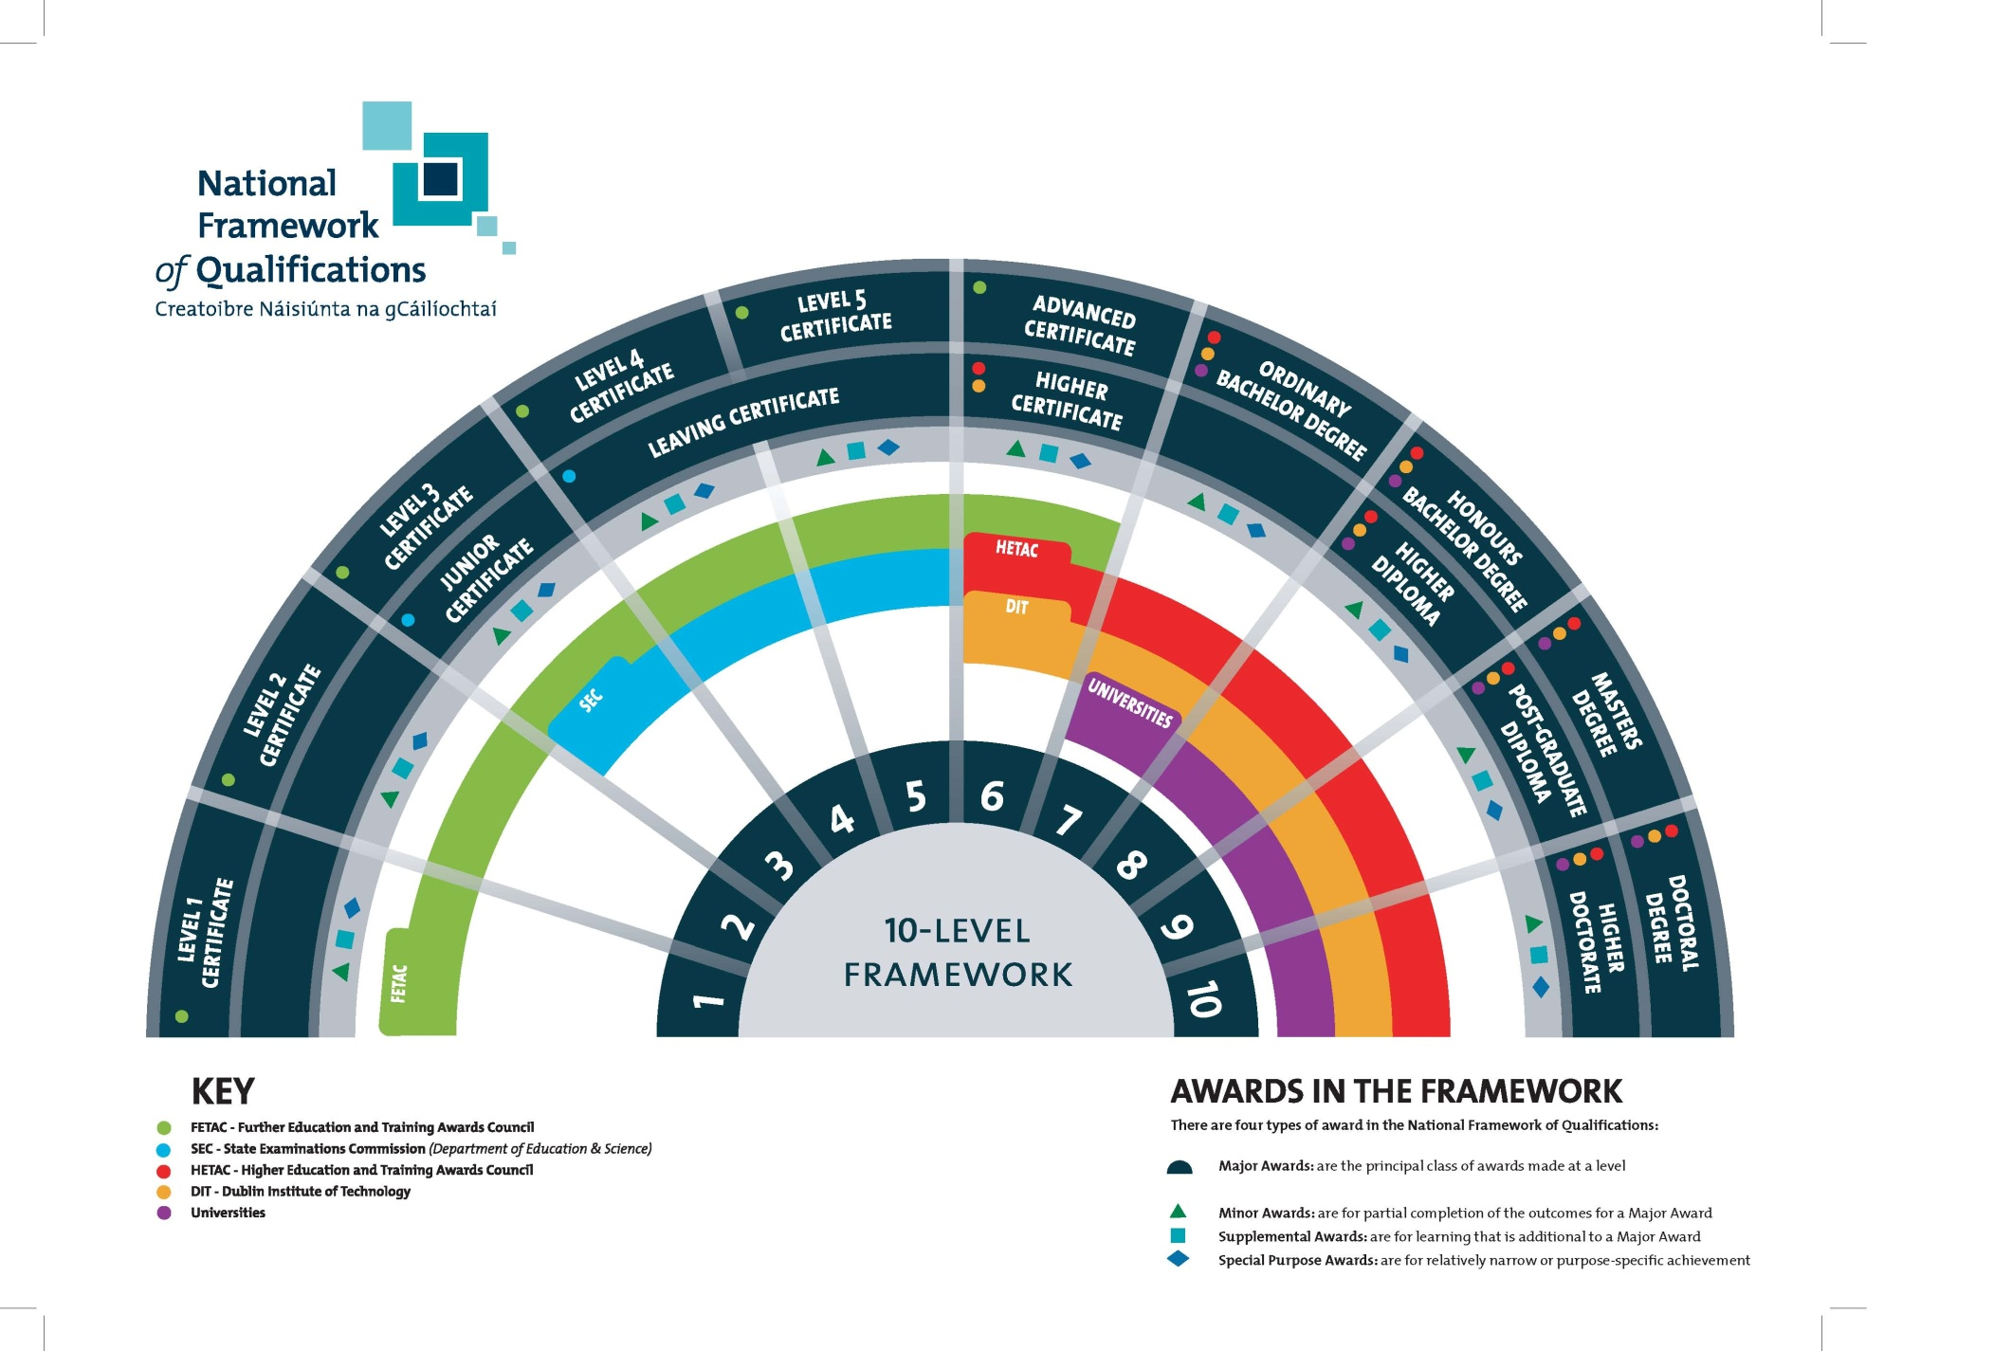
Notes:
24

Slide 25
Levels 6, 7 and 8:
Students have 20 choices in CAO
10 choices from level 8 courses and 10 from of level 6 and 7 courses
Each list of 10 choices are treated independently
In August Students will hopefully get 2 offers
1 offer from level 8 choice and 1 offer from level 6 choice
Choices on one list do not affect the other.
Treated as two independent separate lists

Slide 26
The Ladder System:
This system is mainly used in the IT’s
This is when a student enters a course at a level 6/7 but progresses on to a Level 8
Many Level 8’s in the IT’s have an adjoining course in level 6/7 which mean that students can enter the Level 8 once they have their 6/7 qualification

Slide 27
Fourth thing to understand…
4. Genuine Order of Preference

Slide 28



ORDER OF PREFERENCE
If you learn nothing else from this presentation let it be this...
PLACE YOUR COURSE CHOICES IN GENUINE ORDER OF PREFERENCE!
To do otherwise is a grave mistake.
Notes:
28

Slide 29
Genuine Order of Preference:
You do not need to guess what the points are going to be for the courses you are interested in.
Simply list your courses in genuine order of preference from the highest preference 1, to the lowest preference 10.
If you are entitled to an offer, you will be offered the highest preference that you are entitled to.

Slide 30


PLACE ALLOCATION
We will look just at Level 8 courses, but exactly the same process will take place with Level 7/6 courses, and at the same time.
The importance of the applicant placing courses in genuine order of preference will become apparent in the following slides.
Notes:
30

Slide 31

PLACE ALLOCATION
When examination results are released in August they are entered into the CAO computer.
The computer checks each applicant’s results.
For each course the applicant has applied for, the computer first determines if the applicant has the minimum entry requirements for the course.
Notes:
31

Slide 32
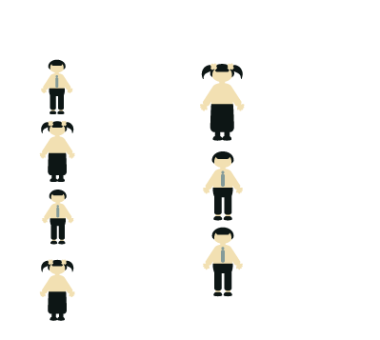
PLACE ALLOCATION
If the applicant meets the minimum entry requirements for the course, the applicant’s points are calculated for this course choice.
All eligible applicants are then placed in a list, in order of academic merit, for each course that they applied for.
Notes:
32

Slide 33

PLACE ALLOCATION
The admissions officers of the Higher Education Institutions tell CAO how many places are to be offered on each course.
CAO then makes offers to the required number of applicants on each course starting with the applicant with the highest points and working down until enough places have been offered.
Notes:
33

Slide 34

PLACE ALLOCATION
Should some applicants decline to accept their offers these places become available in the next round of offers.
They will be offered to the next applicants on the order of merit list. This process continues until all the places on the course are filled or until all the eligible applicants on the order of merit list have been offered places.
Notes:
34

Slide 35
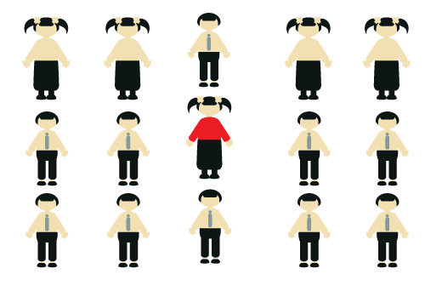
PLACE ALLOCATION:
EXAMPLE
These are the applicants for CK101 Arts in UCC.
The examination results have not yet been released, so these applicants are in no particular order.
We are going to trace the progress of the applicant marked in red.
Notes:
35

Slide 36
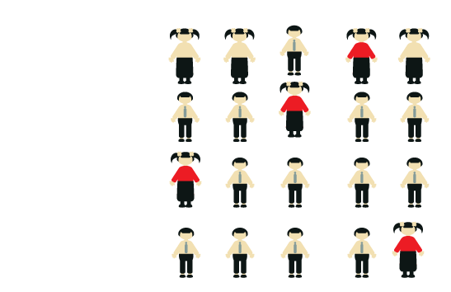
PLACE ALLOCATION
EXAMPLE
Applicants are placed in a queue for each course they applied for, their position in the queue is determined by their points.
The applicant with the highest points is placed at the top of the queue. The points achieved by the applicant in red determines her position in the queue for each course she applied to.
Notes:
36

Slide 37
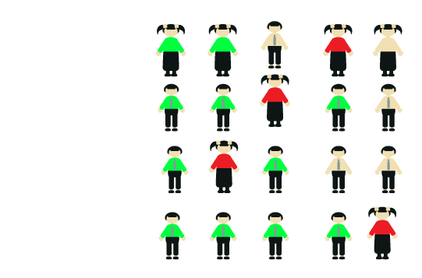
PLACE ALLOCATION
EXAMPLE
The applicants marked in GREEN have enough points to be offered places.
The applicant marked in RED has enough points for her second preference.
Notes:
37

Slide 38

PLACE ALLOCATION
EXAMPLE
The applicant in RED is offered her second preference, the highest preference course that she has enough points for, and she will now disappear from the queue in all her lower choices.
Placing DN201 as her second preference meant that she would prefer to receive an offer on DN201 than on any other course except CK101 - which is her first preference.
Notes:
38

Slide 39

PLACE ALLOCATION
EXAMPLE
Having been offered her second preference she must now decide to accept it or to do nothing. If she does not accept the offer the place will be offered to another applicant in the next round of offers.
Regardless of whether she accepts or not she will still be considered for an offer on her first preference if a place becomes available. In the second round, one more offer was made on CK101 and our applicant is now at the top of the queue.
Notes:
39

Slide 40

PLACE ALLOCATION
EXAMPLE
In the third round of offers two more offers are made on CK101 and our applicant, who was at the top of the queue, now receives an offer.
She may do nothing and remain in DN201 or she may accept the offer and begin in CK101.
Notes:
40

Slide 41
Case Study:
Next diagram will show a student who really wants to do Physiotherapy
Sports Science courses are his second preference
Willing to go anywhere to do course he wants

Slide 42
Level 8: Levels 6 & 7:
Pref: | Course:
1. | Physio (UL) (565*)
2. | Physio (TCD) (533*)
3. | Physio (UCD) (543)
4. | Physio (RCSI) (532*)
5. | Health and Performance UCD (488)
6. | Athletic Therapy and Training DCU (484)
7. | Sport and Exercise Science (UL) (441)
8. | Sports Rehab and Athletic Therapy (Carlow IT) (440 )
9. | Sport Science and Health (DCU) (467)
10. | Science (spec in physiology)(NUIG) (400)
Pref: | Course:
1. | Physiology and Health (Carlow IT) (454)
2. | Strength and Conditioning in Thurles (234)
3. | Health and Leisure ITT(204)
4. | Sport Coaching and Business Management (Carlow IT) (700 – combination of points and portfolio)
5. | Health Science and Physiology (Sligo IT 298)
6.
7.
8.
9.
10.

Slide 43
Case Study:
In this example the student scored 530 in his Leaving Cert therefore the highest course he was eligible for on his Level 8’s was his 5th choice which was Health and Performance in UCD.
He also had enough points for numbers 6-10 but because he had Health and Performance in Dublin higher up than those four they will disappear and he will ONLY be offered Health and Performance in UCD on the level 8 side
He will also be offered a level 6 in Health and Physiology in Carlow IT and choose between the two.
Therefore the student will have two offers and will then be able to make a decision between the two.

Slide 44
Case Study:
Once this student has completed his Level 8 in Sports Science he can apply for Grad entry to Physiotherapy in UCD, RCSI, UL or many colleges in the UK
Having studied a relevant degree means he can apply for 2 year grad entry to Physiotherapy in Ireland and the UK
Many postgrad entries to Physiotherapy require students have a degree in Biology, Exercise Science, Physiology etc

Slide 45
Past Pupil Disaster!!!!
How her CAO looked in May!!!!
Psychology and Education (Mary I) (552)
Psychology NUIG (507)
Psychology UL (495)
Psychology and Sociology UL (478)
Psychology UCC (509)
Arts NUIG (300)

Slide 46
Past Pupil Disaster!!!!
What she changed it to in July!!!!
Arts NUIG (300) Education and Psychology (Mary I) (552)
Psychology NUIG (507)
Psychology UL (495)
Psychology and Sociology UL (478)
Psychology UCC (509)

Slide 47
Remember:
Listing courses in Order of Preference –should be done according to course/area of interest not just a focus on a college you want to go with

Slide 48

GENUINE ORDER
You do not need to guess what the points are going to be for the courses you are interested in.
Simply list your courses in genuine order of preference from the highest preference 1, to the lowest preference 10.
If you are entitled to an offer, you will be offered the highest preference that you are entitled to.
Notes:
48

Slide 49
How to Apply to CAO?
Now you understand how the system works and places are allocated let’s look at how you actually apply for the CAO.

Slide 50
Making an Application:
Apply online
Log onto www.cao.ie
Click on Apply and enter the information requested

Slide 51
Application Form:
Information which identifies the applicant is of utmost importance
Carefully enter details such as your name, address, date of birth, schools attended, etc.
Your examination details must be entered with great care.

Slide 52
Two Systems in One:
It is possible to receive an offer on both lists.
You may then decide to accept either your Level 7/6 or your Level 8 offer.
Alternatively, you might not wish to accept either offer.

Slide 53
Change of Mind Facility:
You may use this facility to change the order of your course choices and/or to introduce new courses, subject to the restrictions detailed in the handbook.
The Change of Mind opens in 5th May and closes on the 1st of July at 5:15pm.

Slide 54
Statement of Application:
Before the end of May applicants will be sent a Statement of Application Record as a final acknowledgement and to enable you to verify that all information has been recorded completely and correctly.

Slide 55
Check the following carefully and if there is any error or omission amend the Statement and return it to CAO:
:
Are all the courses shown and in the correct order?
Are all the codes correct?
Are the exam numbers correct?
Are all exams mentioned?
Are all exemptions listed?

Slide 56
Common Questions at Offer Time:
I have received an offer of my 2nd preference course – if I accept this offer does this mean I won’t get any further offers?
I have the points, why didn’t I receive an offer?
I have not received any offers, what are my options?
I received my 3rd preference course but I would prefer my 4th, what should I do?

Slide 57
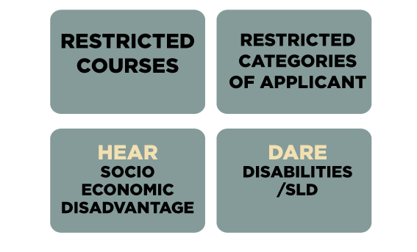
Deadlines to be aware of by 1st of Feb:

Slide 58
Restricted Courses:
Care must be taken with courses that are marked restricted -these are marked clearly in handbook
These courses cannot be applied for after 1st of February because they have extra assessments eg. some art courses, medicine, music and architecture.

Slide 59
HPAT Test for medicine:
Medicine is no longer a restricted course
However, students cannot apply for medicine unless they have sat the HPAT
Register to sit HPAT in early November (once have CAO number) until 20th Jan
Exam is on 22nd of February only at a number of locations
Results released late June

Slide 60
Courses that require portfolios or auditions may not necessarily say restricted but...
UL Architecture: Submissions are accepted between Tuesday 14th April 2020 and Friday 17th April 2020 during normal office hours (Monday to Friday 8.30am–1pm and 2pm–4.00pm).
Product Design UL - Portfolio submission deadline 17TH April 2020
Performing Arts UL – audition in March
LIT Art and Design – Portfolio assessments begins in March

Slide 61
Applications for HEAR and DARE:
Applications for both HEAR (students from Socio-economically deprived groups) and DARE (students with specific learning difficulties must be made by the 1st February

Slide 62
What is DARE?
DARE is Disability Access Route to Education
Some HEI’s take account of the impact of a disability and/or specific learning difficulty on a student’s educational performance.
May receive a reduction in points for entry to courses but must still meet minimum entry requirements

Slide 63
Students eligible for DARE:
Autism
ADD/ADHD
Blind/Vision impaired
Deaf/hard of hearing
Dyspraxia (Please note that a stand-alone diagnosis of “dysgraphia” is no longer accepted for DARE. It will be considered if it is presenting as part of/ as a result of DCD or Specific Learning Difficulty (SLD; including dyslexia and dyscalculia).
Mental Health Conditions
Neurological conditions eg. Epilepsy
Significant ongoing illness eg. Diabetes
Physical Disability
Speech and Language Communication Disorder
Specific Learning Difficulty eg. Dyslexia

Slide 64
Colleges that take part in DARE:
AIT Marino
CIT Mary I
DCU Maynooth
DIT NUIG
IADT RCSI
IT Carlow TCD
IT Sligo UCD
LIT UCC
UL St Angela’s Sligo

Slide 65
DARE:
Not all students who apply for DARE get accepted, it depends on:
overall number of places
number of places reserved for DARE
number of eligible DARE applicants that apply

Slide 66
Additional Info:
Prioritisation of students with physical and sensory disabilities as they are particularly under- represented in Third Level
Prioritisation of applicants eligible for both HEAR and DARE
For students presenting with Dyslexia, Dyspraxia or Dysgraphia a psychological report of any age will be accepted

Slide 67
Please note:
You don’t have to be eligible for DARE to get support in college.
All students with a verified disability regardless of whether got into college through DARE can avail of academic, personal and social supports in college

Slide 68
DARE Dates of Importance:
Apply to CAO by Feb 1st
By 1st of March tick the box on CAO to say ‘YES’ to the question ‘Do You wish to be considered for DARE and student must have filled in Section A of the Supplementary Information Form in their DARE Form

Slide 69
DARE Dates of Importance:
Section B is to be filled in by Guidance Counsellor
Section C must be completed by the appropriate medical professional – applicants with a specific learning difficulty send in a psychological report instead of Section C
Section B and C must be received by the CAO by the 15th of March – Applicant's responsibility to REGISTER POST b and C together

Slide 70
HEAR:
HEAR is a college and university scheme which offers places on reduced points and extra college support to school leavers from socio-economically disadvantaged backgrounds
HEAR applicants must meet a range of financial, social and cultural indicators to be considered for a reduced points place

Slide 71
To be eligible:
You must meet indicator 1 plus a correct combination of 2 other indicators to be eligible for HEAR

Slide 72
Should I apply for HEAR:
1. Income –family income falls on or below the HEAR Income limit (Calculated by how many children in the family and how many people in the family in full-time education
2. Medical Card – your family has a medical card
3. Means Tested Social Welfare- your family received a means tested payment from the Department of Social Protection

Slide 73
Should I apply for HEAR:
4. Socio-economic group- You belong to a group that is under-represented in higher education eg.Non-manual Workers Group and Semi and Unskilled Manual Workers, Agricultural workers, FAS scheme workers, those who have never been in formal employment, those who are permanently unfit for work due to illness and applicants in the Care of the State
5. DEIS school attendance –you have completed 5 years in a DEIS secondary school

Slide 74
HEAR Indicators:
6. Area profile – you live in an area where there is high unemployment and poverty and only a small number of adults in the area have. Applicants can get an indication of the classification of their address by using the Area Deprivation User Guide available on www.pobal.ie

Slide 75
HEAR Indicator 1:
Number of dependent children | HEAR Income Limit
Fewer than 4 | €45,790
4-7 | €50,325
8 or more | €54,630
Add €4,670 to the total family/household income for every sibling/parent enrolled in a full time college, university or post leaving certificate course.

Slide 76
HEAR Key Dates:
1st Feb: Apply to CAO
1st March: Final date for completing online HEAR Application Form
15th March: Send all supporting documentation to CAO

Slide 77
HEAR/DARE Booklets:
If require more information regarding either HEAR/DARE applications information booklets are available
Also accesscollege.ie contains all the relevant information
Information Clinic on HEAR and DARE on 11th of Jan in UL 10am-2pm

Slide 78
HEAR is not to be confused with grant system SUSI:
Third Level grants available through SUSI
www.susi.ie is the website with all relevant information on student grants etc
Applications for 2020 not open yet but last year opened in May and the closing date was the 1st of August
Can use the Eligibility Reckoner to see if eligible for a Grant at any stage

Slide 79
SUSI:
Two types of Third Level grants available through SUSI:
1. Maintenance grants:
A maintenance grant is a contribution towards the living costs of the students and is paid directly into the student’s bank account in nine monthly instalments.
Maintenance grants are paid at an adjacent and non-adjacent rate. Students must ordinarily reside over 45km from where they intend to study to be eligible for the non-adjacent rate.
2. Fee grants:
A fee grant is made up of three elements (tuition fee element, student contribution element and a field trip element).
Your household income and the approved course you are attending will determine what elements of this grant you may receive.

Slide 80
SUSI:
You can tick a box on CAO application to say you wish to be considered for Maintenance Grant
Ticking this section of the CAO DOES NOT mean that you have applied for SUSI it is just allowing information to be shared to SUSI

Slide 81
Alternative Pathways to reach Careers:
1. UCAS/Eunicas applications
2. Graduate entry eg. Physiotherapy, Medicine, OT, Pharmacy
3. Professional exams eg. Stockbroking, Actuarial Studies, Accounting
4.Consider all colleges – there can be a huge difference in points
5. The Ladder System eg. Levels 6 and 7
6. PLC Entry

Slide 82
Deadline for Applying to the UK:
Deadline for Medicine, Veterinary, Dentistry and applications to Oxford and Cambridge have past (15th of October)
However, deadline for all applications to other courses such as Physio, Psychology etc. is not until 15th of Jan
Please note there have been major changes to NHS funding for courses such as nursing, physio, OT etc
Free fees for Irish students in Scotland

Slide 83
Studying in Europe:
Thousands of Irish students decide to study abroad every year
Particularly popular for high demand programmes like Medicine and Veterinary
43 of 81 First Years in Vet Medicine in Warsaw are Irish!
Need to research thoroughly –can apply with Eunicas.ie and they will assist you with the application

Slide 84
Studying in Europe:
Deadlines for European colleges vary - www.eunicas.ie is the website should consult if considering attending college in Europe

Slide 85
Graduate Entry:
Graduate Entry to a course means you can apply for a course if you already have a level 8 and want to continue study in another area
Once you complete a Level 8 you are a GRADUATE
Can then apply for courses on the POSTGRAD system

Slide 86
2 Types of Postgrads:
Some Postgraduate and Masters courses allow you to specialise further Eg. Sports Physiotherapy (after complete Physio degree)
Eg. Clinical Psychology (after complete a Psychology degree)
Eg. Masters in Digital Marketing after degree in Business

Slide 87
2nd Type of Postgrad:
Other Masters allow you to convert your first degree into something completely different or something different but related in some way
These can usually be done as accelerated degrees meaning they are quicker – 2 yrs
Can also be known as ‘Conversion Courses’

Slide 88
Examples of Graduate Entry:
Can qualify as Occupational Therapy, Speech and Language Therapy and Physio in 2yrs in UL. Results from HPAT for OT and S&L and the GAMSAT for Physio are the only determining factor for entry.
Graduate entry to Medicine:4 yrs: Open to students of all disciplines – must do GAMSAT

Slide 89
Examples of Graduate Entry:
2 year grad entry qualification in Dietetics also available in UL: Open to graduate with degrees in areas such as Food Science, Nutrition, Biochemistry etc
2 year grad entry qualification to Radiography in UCD and UCC: Open to graduates of degrees in health sciences and science

Slide 90
Examples of Grad Entry:
The 2 year Grad Dip in Primary Teaching is available for graduates of all disciplines but students must still have their H4 in Irish. This is also available in the UK.
The 2 year PME is available in Second Level Teaching for those who have a relevant degree in a teaching subject

Slide 91
Professional Training:
Many graduates starting work will have the opportunity to train for professional qualifications.
The area of business and finance is particularly noted for new graduates following specific professional exams, for example in accountancy, taxation, stockbroking, insurance, banking, marketing or human resources.
Law also requires further study following an undergrad
Some degrees can offer exemptions from professional exams eg. Accounting, Actuary,

Slide 92
Professional Qualification:
Other more technical careers such as engineering or surveying also give the chance to study for a professional qualification.
Professional qualifications allow access to relevant professional body and the range of resources and contacts they offer for further career development.

Slide 93
Postgrad Routes:
Some graduates from certain areas use the competencies they developed to go in a completely different career direction
Eg. Engineers can use numerical skills in areas like actuary, computing, accounting etc.

Slide 94
Other Alternatives:
Apprenticeships and trade
The Guards and other public sectors recruit at different times of the year and if interested in these areas keep an eye on Publicjobs.ie for advice on interviews and recruitment
military.ie: All competitions for the army will be advertised on this website (follow on Facebook and will be informed)
All recruitment campaigns are announced on Careersportal.ie

Slide 95
Apprenticeships:
Apprenticeships in Ireland are experiencing an overhaul and there is a growing interest in this area
Students had the opportunity to come to went to Midwest Apprenticeship and Traineeship Careers Showcase in Limerick in early October
Will also have an opportunity to visit the Shannon Training Centre in the new year

Slide 96
Apprenticeships:
In response to our high drop out rates in Third Level (1 in 6 drop out) there is a growing demand for apprenticeships and a growing awareness that college and formal third level education is NOT for everybody –how could it be???
2 Types of Apprenticeships: Traditional and New

Slide 97
Traditional Apprenticeships:
Examples include plasterer, electrician, mechanic, toolmaking and ag mechanic
Takes 4 years in total – 7 phases (4 with employer and 3 in college)
Level 6 qualification
Paid while doing the apprenticeship – amount depends on area of training

Slide 98
How to organise an Apprenticeship?
Need to find a qualified person in area of interest to take you on so you can train in this area
Can be very competitive esp. ESB and Aircraft Maintenance eg. Atlantic Aviation 1800 applicants for 12 places last Summer
Selection for Atlantic Aviation includes aptitude results, aptitude tests, hand skills assessment and interview

Slide 99
Changes...
Since 2016 many new occupational apprenticeships are in the process of being developed and introduced in the Computer & ICT, MedTech, Insurance, Finance, Accountancy, Logistics and Hospitality sectors.
Some have been launched recently

Slide 100
Examples of New Apprenticeships:
Engineering: Manufacturing Technology, Manufacturing Engineering (eg. Johnson and Johnson, Takumi Precision Engineering )
Finance: Accounting Technician, Insurance Practice, International Financial Services Associate (Grant Thornton, Limerick)
Qualifications in levels 6,7 and 8

Slide 101
Example of New Type of Apprenticeship:
The Insurance Practitioner Apprenticeship is an ‘earn and learn’ degree programme that combines on-the-job training with academic study.
Developed by The Insurance Institute and representatives from across the industry, this three-year programme leads to a BA (Hons) in Insurance Practice from IT Sligo – a qualification future employers will crave.
Will learn the skills, knowledge and behaviours necessary for a successful career in insurance and beyond, as well as also earning a salary as you study.
It involves four days per week on-the-job training, and one day per week off-the-job and online.
Register interest online

Slide 102
Examples of New Apprenticeships...
The Apprenticeship in Industrial Electrical Engineering has been specifically designed as a progression programme for qualified electricians who wish to upskill and to acquire advanced knowledge to move into engineering roles in Industry.
The apprenticeship is a 2 year programme, with an approved employer.
70% of the time is spent on the job and the remaining 30% of the time is spent in Limerick Institute of Technology (LIT).

Slide 103
More information:
www.apprenticeship.ie
Download App: Midwest Apprenticeship App (google and then download)

Slide 104
PLC Entry:
PLC courses are one year courses that many students use to gain entry to third level
This qualification is a level 5 – the same as the Leaving Certificate
If students remain on for a second year they will gain a Level 6

Slide 105
Reasons students do a PLC?
To gain a qualification in a specific area eg. Beauty Therapy, Dental Secretary, Pharmacist Assistant
To use the PLC as a stepping stone to gain entry to a college course the following year
To explore an area of interest and see if suits before going into Third Level system

Slide 106
Two systems of entry with PLCs:
1. Quota System
2.Points System

Slide 107
1. Quota System:
1. Some universities and popular courses such as nursing reserve small quotas of places on some programmes for FETAC applicants, who are presenting with FETAC Level 5 awards in courses with modules RELATING in content to the course they are applying to.

Slide 108
Quota System:
When quotas apply, FETAC applicants compete with other FETAC applicants for the places in question.
Students must get certain grades in PLC eg. Distinctions in certain modules
This entry is can be very competitive and students are not guaranteed entry

Slide 109
2. Points Scheme:
In this system PLC graduates compete for college places with Leaving Certificate students based on points.
PLC students (level 5) students can achieve a maximum of 400 points.
This system is used by the ITs NOT the universities
Application for these programmes is through the CAO system

Slide 110
NOTE:
Not all courses in the universities accept a FETAC qualification as an entry requirement eg. No FETAC entry for Medicine
It is listed clearly in websites such as Careersportal or the prospectuses whether a FETAC entry route is available or not.

Slide 111
Examples of popular PLC colleges:
Limerick College of Further Education
Central College Limerick
Galway Technical Institute
St Patrick’s Comp Shannon
Students apply directly to the COLLEGES for these places not the CAO – applications open on college websites around Jan/Feb

Slide 112
Please Note:
Students can apply for the CAO and a PLC/Apprenticeship/UK/Europe and then decide which they want in August when CAO offers are released
Students can apply for a deferral and spend a year doing a PLC to see if they are certain about their area of interest

Slide 113
Other things to bear in mind..
An initiative is being launched to combat the alarming drop-out rates of across Ireland’s third-level institutions
According to data from the HEA, a total of 6,414 (1 of 6 of all first years students) quit their college courses in 2017.
Bulk of abandoned courses are in sectors like Science, Technology, Construction and Business.

Slide 114
Drop-Out Rates:
In general, university courses have the lowest drop-out rates (between 10 and 12 per cent), while they are about twice that in Institutes of Technology.
The highest rates of non-progression are concentrated among higher certificate (level six) and ordinary degree (level seven) courses at institutes of technology, which typically require relatively low points in the Leaving Cert

Slide 115
Why are so many dropping out of college?
Higher education institutions say moves towards broader entry – preventing students from having to decide, at an early stage, what specialism might suit them later in life – will help to ease pressure on students and reduce the drop-out rate.

Slide 116
What is the cost of college in Ireland?
3,000 registration fee per year of college
The Government pay a balance of approx. 4,500

Slide 117
Something to note...
If you are very unhappy in your course you should drop out by the 30th of Oct to protect free fees for the next year
The next deadline should drop out by is 30th Jan as will lose half fees
If drop out after the 30th of Feb will have to pay full fees if change a course the next year

Slide 118
Best Careers List in Ireland
Finance and Accounting
Mathematical/ Quantitative areas
Science - Pharmaceutical, biotechnology, medical device
Engineering
Technology and Computers

Slide 119
Shift in the Job Market..
Demand for students with transferable skills such as an ability to critically and logically think, to work in a multicultural environment, adaptability, communication etc

Slide 120
Campus Accommodation
Keep an eye on college websites to register for campus accommodation
Dublin universities, UCC and NUIG particularly difficult to get accommodation so keep an eye on websites from Jan onwards

Slide 121
The CAO Book:
The CAO book has all relevant information about the Application process and has a list of all courses that are available.
Careersportal.ie has a list of all courses that are available and also their points from last year

Slide 122
Remember!
It is important that the student is around for the time immediately after the Leaving Certificate results in order to take care of the following:
accepting their offer
Viewing of scripts if necessary
Deciding on getting paper rechecked

Slide 123
What help do students get?
Specific classes throughout the year – on during Religion
Scheduled individual appointment with Ms.Fitzpatrick
Can attend different talks – students sign up for any Talks of interest eg Hotel Management, Arts, Primary Teaching, GMIT and Science in UL next weweketc
Familiar with websites such as Careersportal etc. (Careers module in LC1 for 8 weeks)
Parents are welcome to make an appointment if need to discuss something in detail

Slide 124
Useful websites:
www.cao.ie
www.ucas.com
www.eunicas.com
www.careersportal.ie
www.gradireland.ie
www.apprenticeship.ie

Slide 125
Useful Videos:
There are some useful videos uploaded to the School Website to give further information including How the CAO Works, How to use CAO Change of Mind, Understanding the Statement of Application

Slide 126

Thank You for listening!
If still feeling confused powerpoint will be available to look over on the Guidance section on the St.Caimin’s website!

