Slide 1
Third Year Options
Parents Information Evening

Slide 2
What is the LCA course?
It is a distinct, self-contained two-year Leaving Certificate programme aimed at preparing learners for adult and working life.​
It emphasises forms of achievement and excellence which the established Leaving Certificate has not recognised in the past.​
It offers learners specific opportunity to prepare for and progress to further education and training.​

Slide 3
Who would benefit most from the Leaving Certificate Applied?
Learners who are not adequately catered for by the traditional Leaving Certificate and the LCVP programme.
Students who up to now have found it difficult to engage with their learning.
Students who may wish to apply to colleges with direct entry options eg. Portfolios and interviews as opposed to the points system
Those considering PLC's, certain apprenticeships or those going directly into the workforce after second level education

Slide 4
Rationale for LCA
Prepares learners for the demanding transition to adult and working life.
Recognises talents of all learners - programme responsive to aptitudes, abilities, needs and interests.
Provides opportunity to develop in terms of responsibility, self-esteem and self-knowledge.
Develops communication and decision making skills.
Helps learners achieve a more independent and enterprising approach to learning and to life.

Slide 5
Key Underlying Principles
student centred curriculum
personal and social development
integration and cross curricular links
team work
literacy & numeracy development
active teaching/learning methodologies
reflection
community links

Slide 6
LCA Curriculum
Vocational Preparation | Vocational Preparation & Guidance English & Communications
Vocational Education | Mathematical Applications Vocational Specialisms* (Choose 2 from 11 options) Information Communication Technology
General Education | Arts Education (Dance, Drama, Music, Visual Arts) Social Education Languages (Gaeilge and French/Italian/German/Spanish) Leisure & Recreation (including Physical Education) Religious Education

Slide 7
Vocational Specialisms
Engineering
Technology
Childcare/Community Care
Graphics and Construction Studies
Craft and Design
Agriculture/Horticulture
Hotel Catering and Tourism
Hair and Beauty
Office Administration and Customer Care
Active Leisure Studies
Information and Communications Technology
Choose
2
From
11
Options

Slide 8
LCA Modes of Assessment
Satisfactory completion of modules + 90% attendance Evidence of completion of 4 key assignments for each module One credit per course module in which there is a final exam Two credits per course module in which there is NO final exam | 62 credits | 31%
7 Student tasks @ 10 credits each | 70 credits | 35%
Final examinations | 68 credits | 34%
Total | 200 credits | 100%
Vocational Preparation | Vocational Education (x2) | General Education
Contemporary Issue | Personal Reflection | Practical Achievement
English & Communication | Vocational Specialisms (x2) | Languages (x2) | Social Education | Mathematical Applications
12 credits | 12 credits each | 6 credits each | 10 credits | 10 credits

Slide 9
Summary of Tasks
Task | Credit | % | Completed in session | Assessed
General Education Originating in Arts Education, Leisure & Recreation, Language or Social Education | 10 | 5 | 1 | Jan/Yr 1
2. Vocational Preparation Originating in either Vocational Preparation & Guidance or English & Communication | 10 | 5 | 2 | May/Yr 1
3. Vocational Education - 1st specialism Originating in one Vocational Specialism | 10 | 5 | 2 | May/Yr 1
4. Vocational Education - 2nd specialism Originating in the second Vocational Specialism | 10 | 5 | 3 | Jan/Yr 2
5. Contemporary Issues Anchored in Social Education | 10 | 5 | 3 | Jan/Yr 2
6. Practical Achievement Generally out of school | 10 | 5 | 3 | Jan/Yr 2
7. Personal Reflection Statement 1 from year one will be stored and returned to SEC when statement two is complete | 10 | 5 | on-going | May/Yr 2

Slide 10
Opening up New Options
The Leaving Certificate Applied Route Map
Leaving Certificate Applied
(QQI Level 4)
Vocational Preparation
Vocational Education
General Education
Further Education
Post Leaving
Certificate
Course
(QQI Level 5 & 6)
Further & Higher Education
(QQI Level 7 - 10)
Careers
SOLAS
Apprenticeships

Slide 11
Irish National Framework of Qualifications (NFQ)

Slide 12
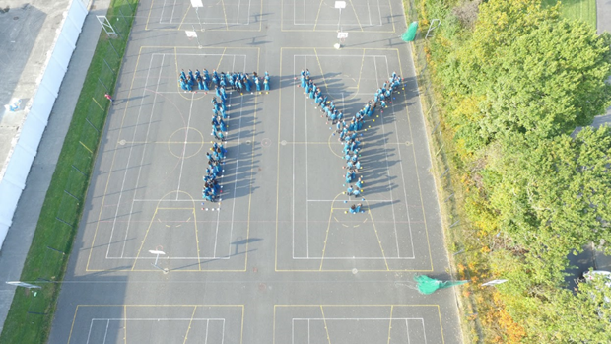
Transition Year Programme
Transition Year Programme
Mr. Tomás Quealy
T.Y. Co-ordinator
Tom.Quealy@stcaimins.ie

Slide 13
What is Transition Year?
The Transition Year (TY) is a one-year programme designed to act as a bridge between the Junior Certificate and Leaving Certificate programmes.
Each school designs its own Transition Year programme, within set guidelines, to suit the needs and interests of its students.
The school promotes the personal, social, vocational and educational development of students.

Slide 14
ESRI & NCCA Report:
Benefits
TY students out-perform other LC students by 26 points and repeat students by 5 points.
Increased maturity
Informed subject and career choices.
Develop a wide skill set.
Positive Experiences.
Enhanced Teamwork.
Concerns
Not for everyone.
A lot of the onus on student participation.
Reduced homework.
Different base classes or separated from friends.

Slide 15
Transition Year Programme
Core Subject
Mathematics
English
Gaeilge.
Religious Education.
MFL
TY Specific and Taster Subjects
Information and Communications Technology
Physical Education
Gaisce/Personal Reflection
Guidance
Enterprise
Options Rotation on an 11-week cycle

Slide 16
Subject Sampling | TY Specific | Calendar Layer
11-week rotation of LC Option Subjects | Careers | Work Experience
Sciences | Enterprise, Woodcraft | Gaisce
Geography, History | SPHE & Personal Development | Outdoor Pursuits
Construction, Engineering | European Parliament Ambassador Schools | Jnr. Achievement
Home Economics, Crafts | Media Studies | Visiting speakers
Music | Computer Applications | Workshops
PE inc. Coaching and S&C | Public Speaking | Trips & Visits out

Slide 17
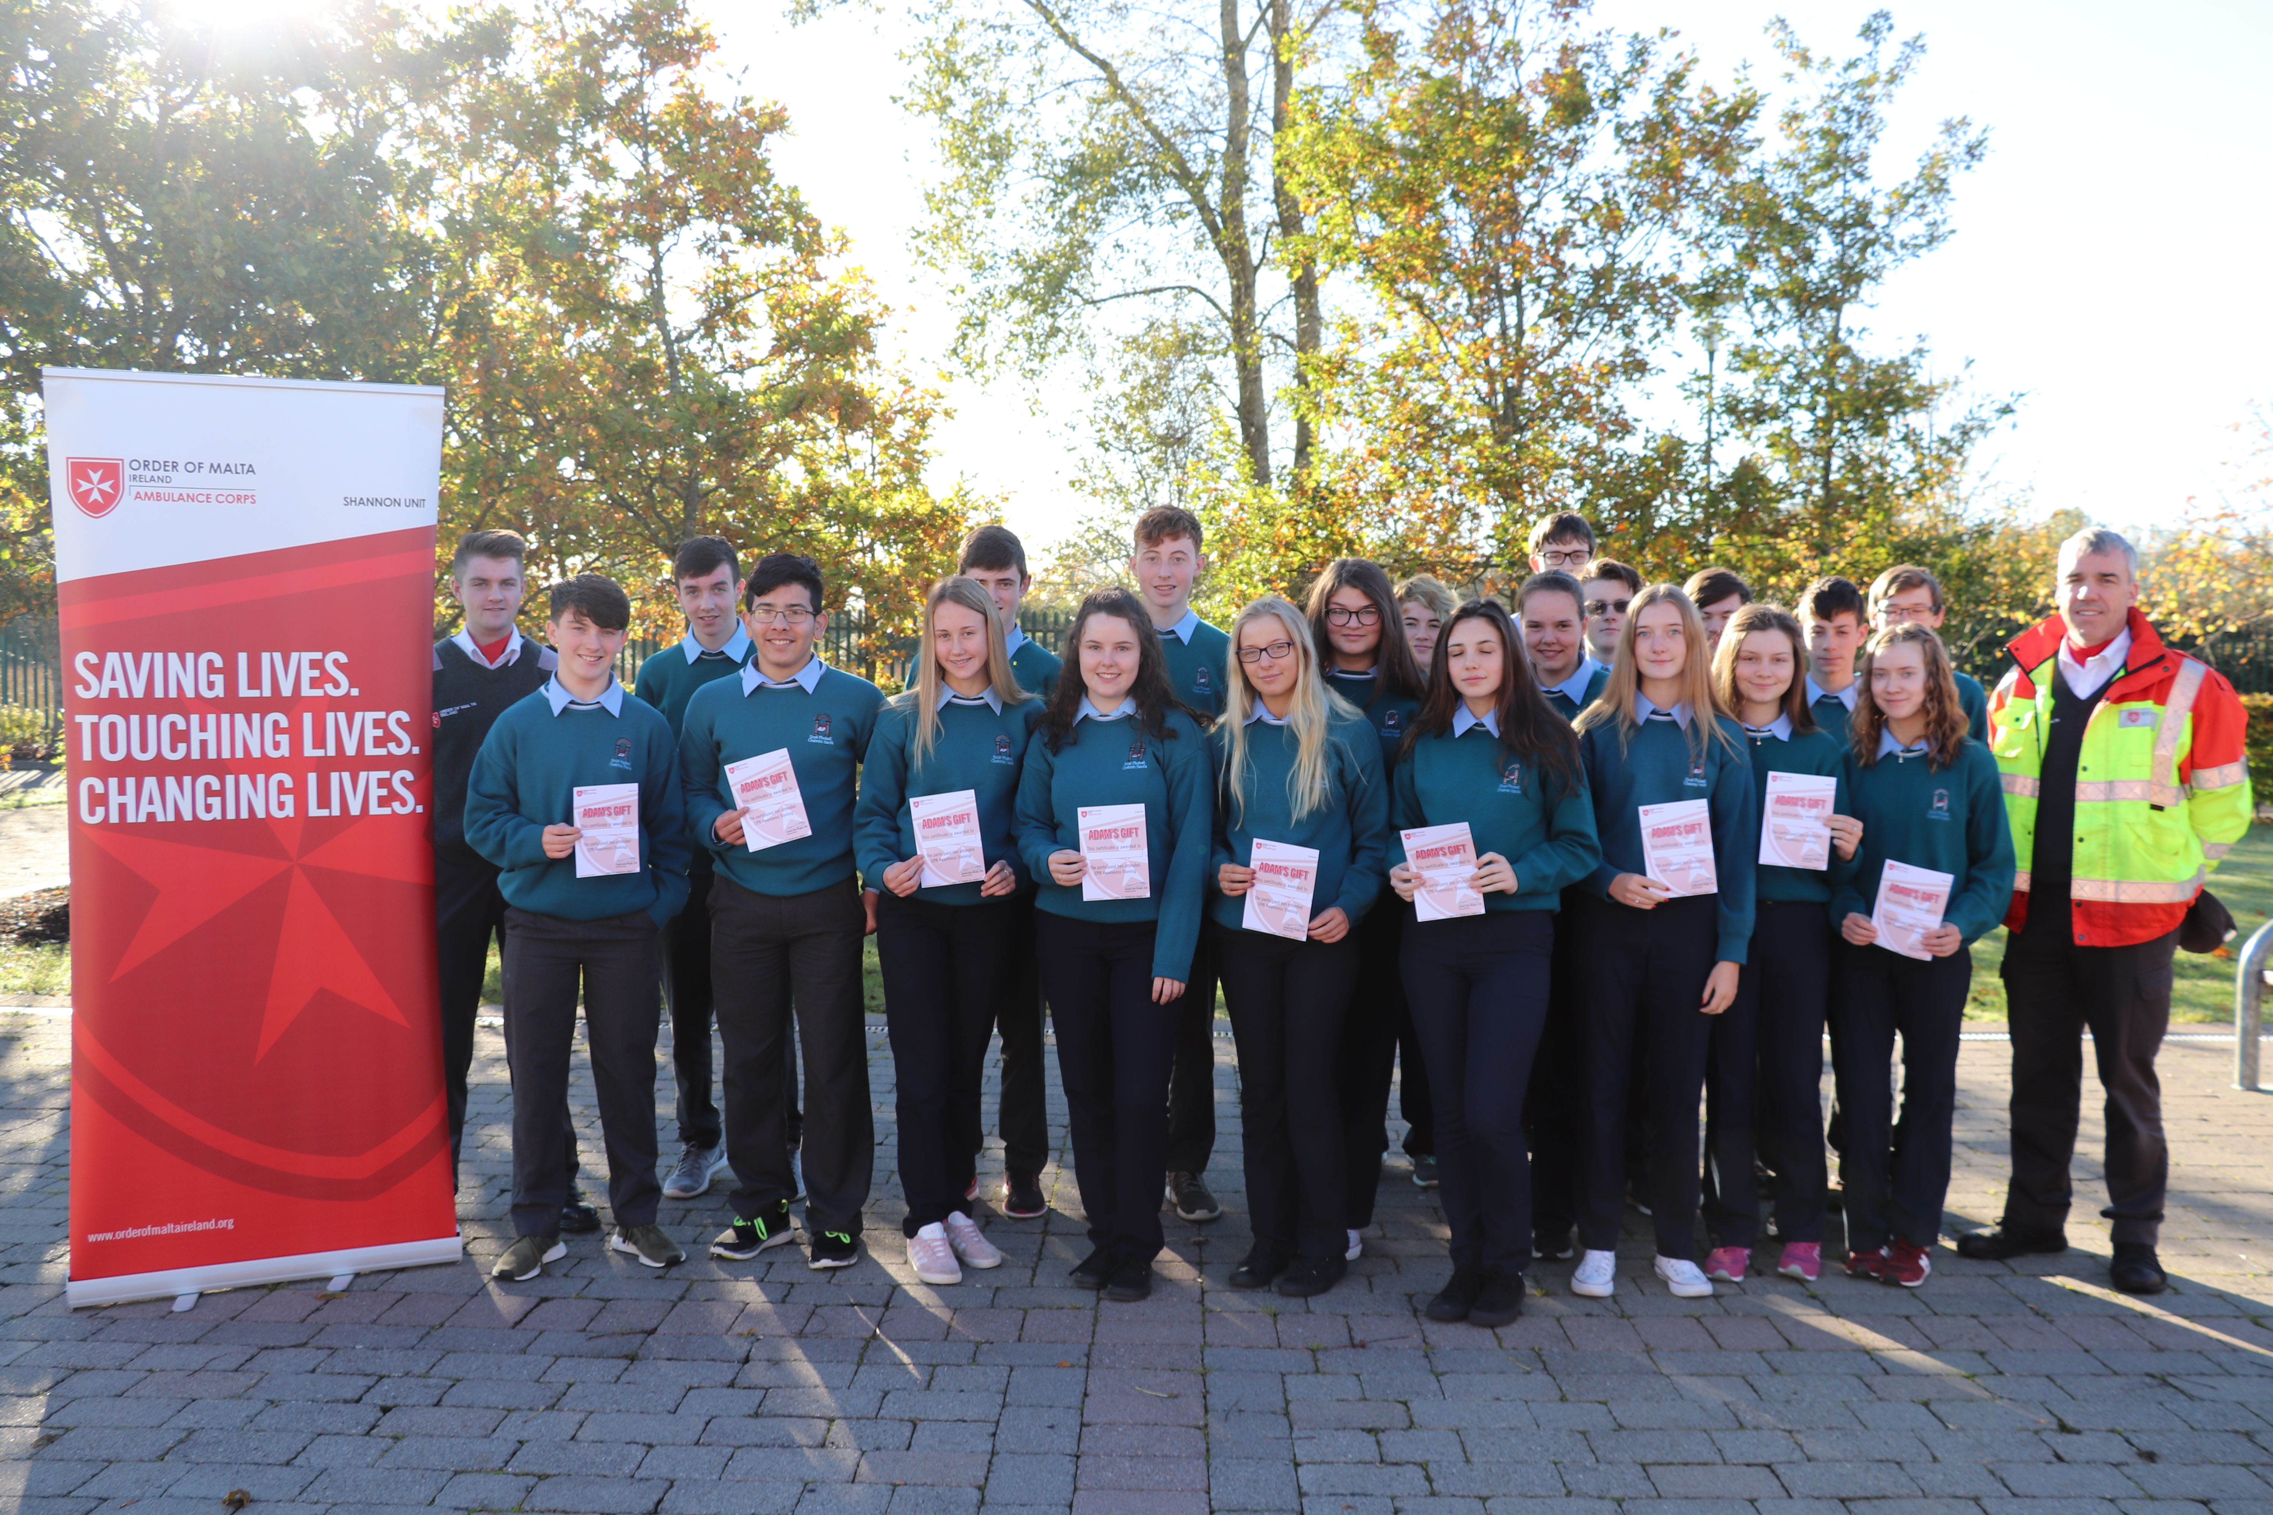
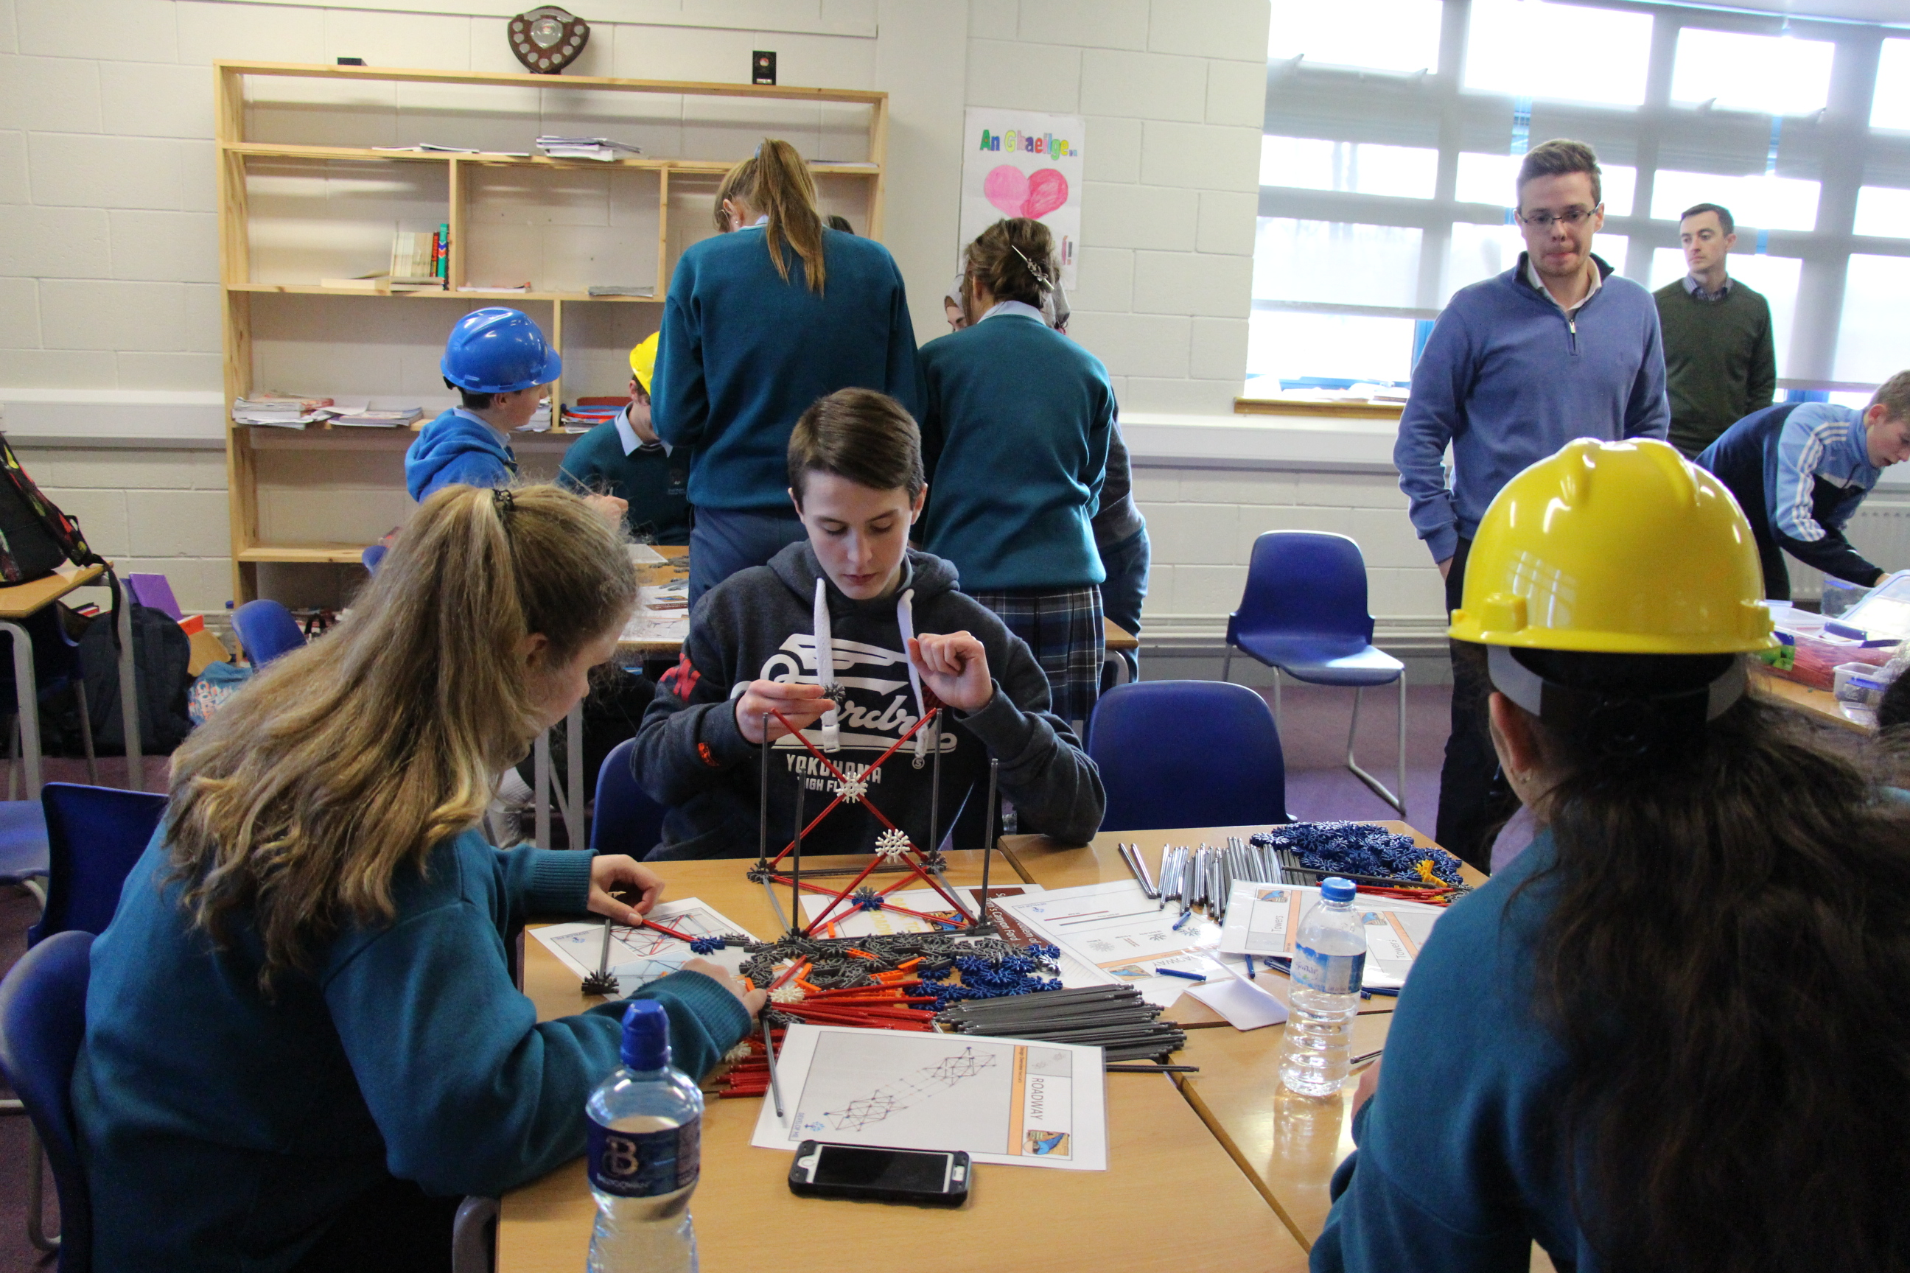
Transition Year Programme
Bodhran-making
Personal Development
Animal Magic
Workshops
Conflict Resolution for Teenagers
Radio/Film
Road Safety

Slide 18
Transition Year Programme
Work Experience will take place every Friday
3-4 Rotations
Find Placement
Week Option
Work Experience
Reflection
Garda Vetting
Insurance

Slide 19
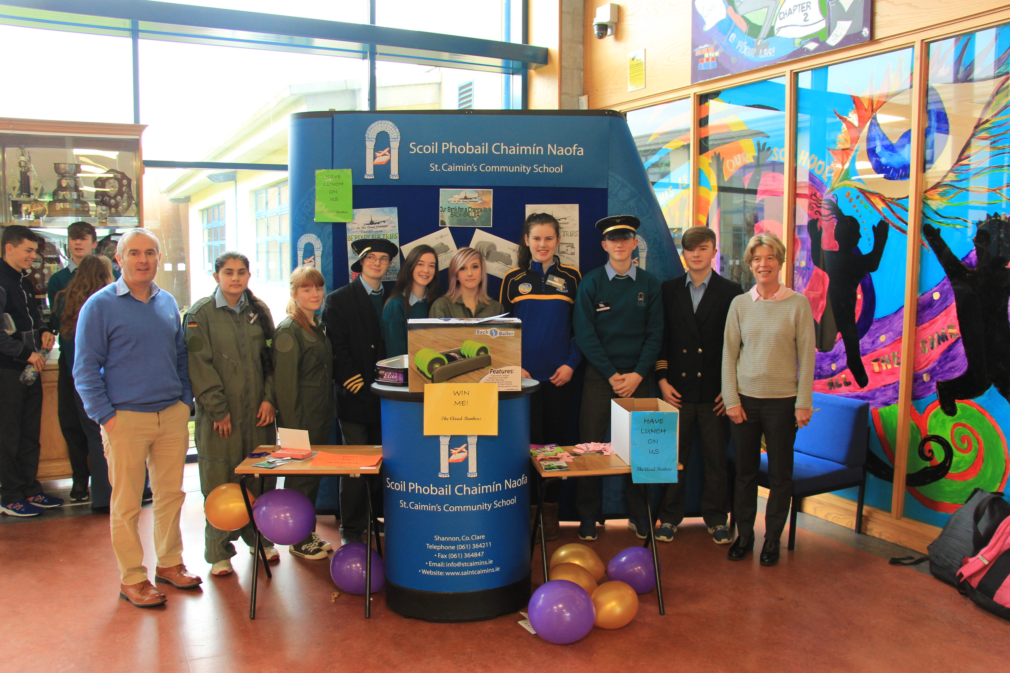
Transition Year Programme
Industry Visits
Christmas Market/School Show
School Bank
Business
Event Management Project
Mentoring
Visiting Speakers

Slide 20
Transition Year Programme
Inspirational Speakers
Billy Kelleher
MEP for Ireland South
Rob Heffernan Olympic Athlete
BOI Ambassador

Slide 21
Transition Year Programme
Future Leaders
First Aid
Junioe Enterprise
Programmes
Gaisce
Accountancy Bootcamp
Junior Achievement

Slide 22
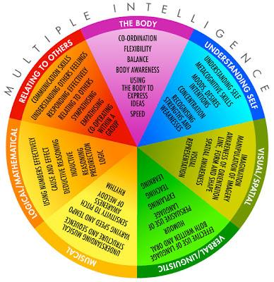
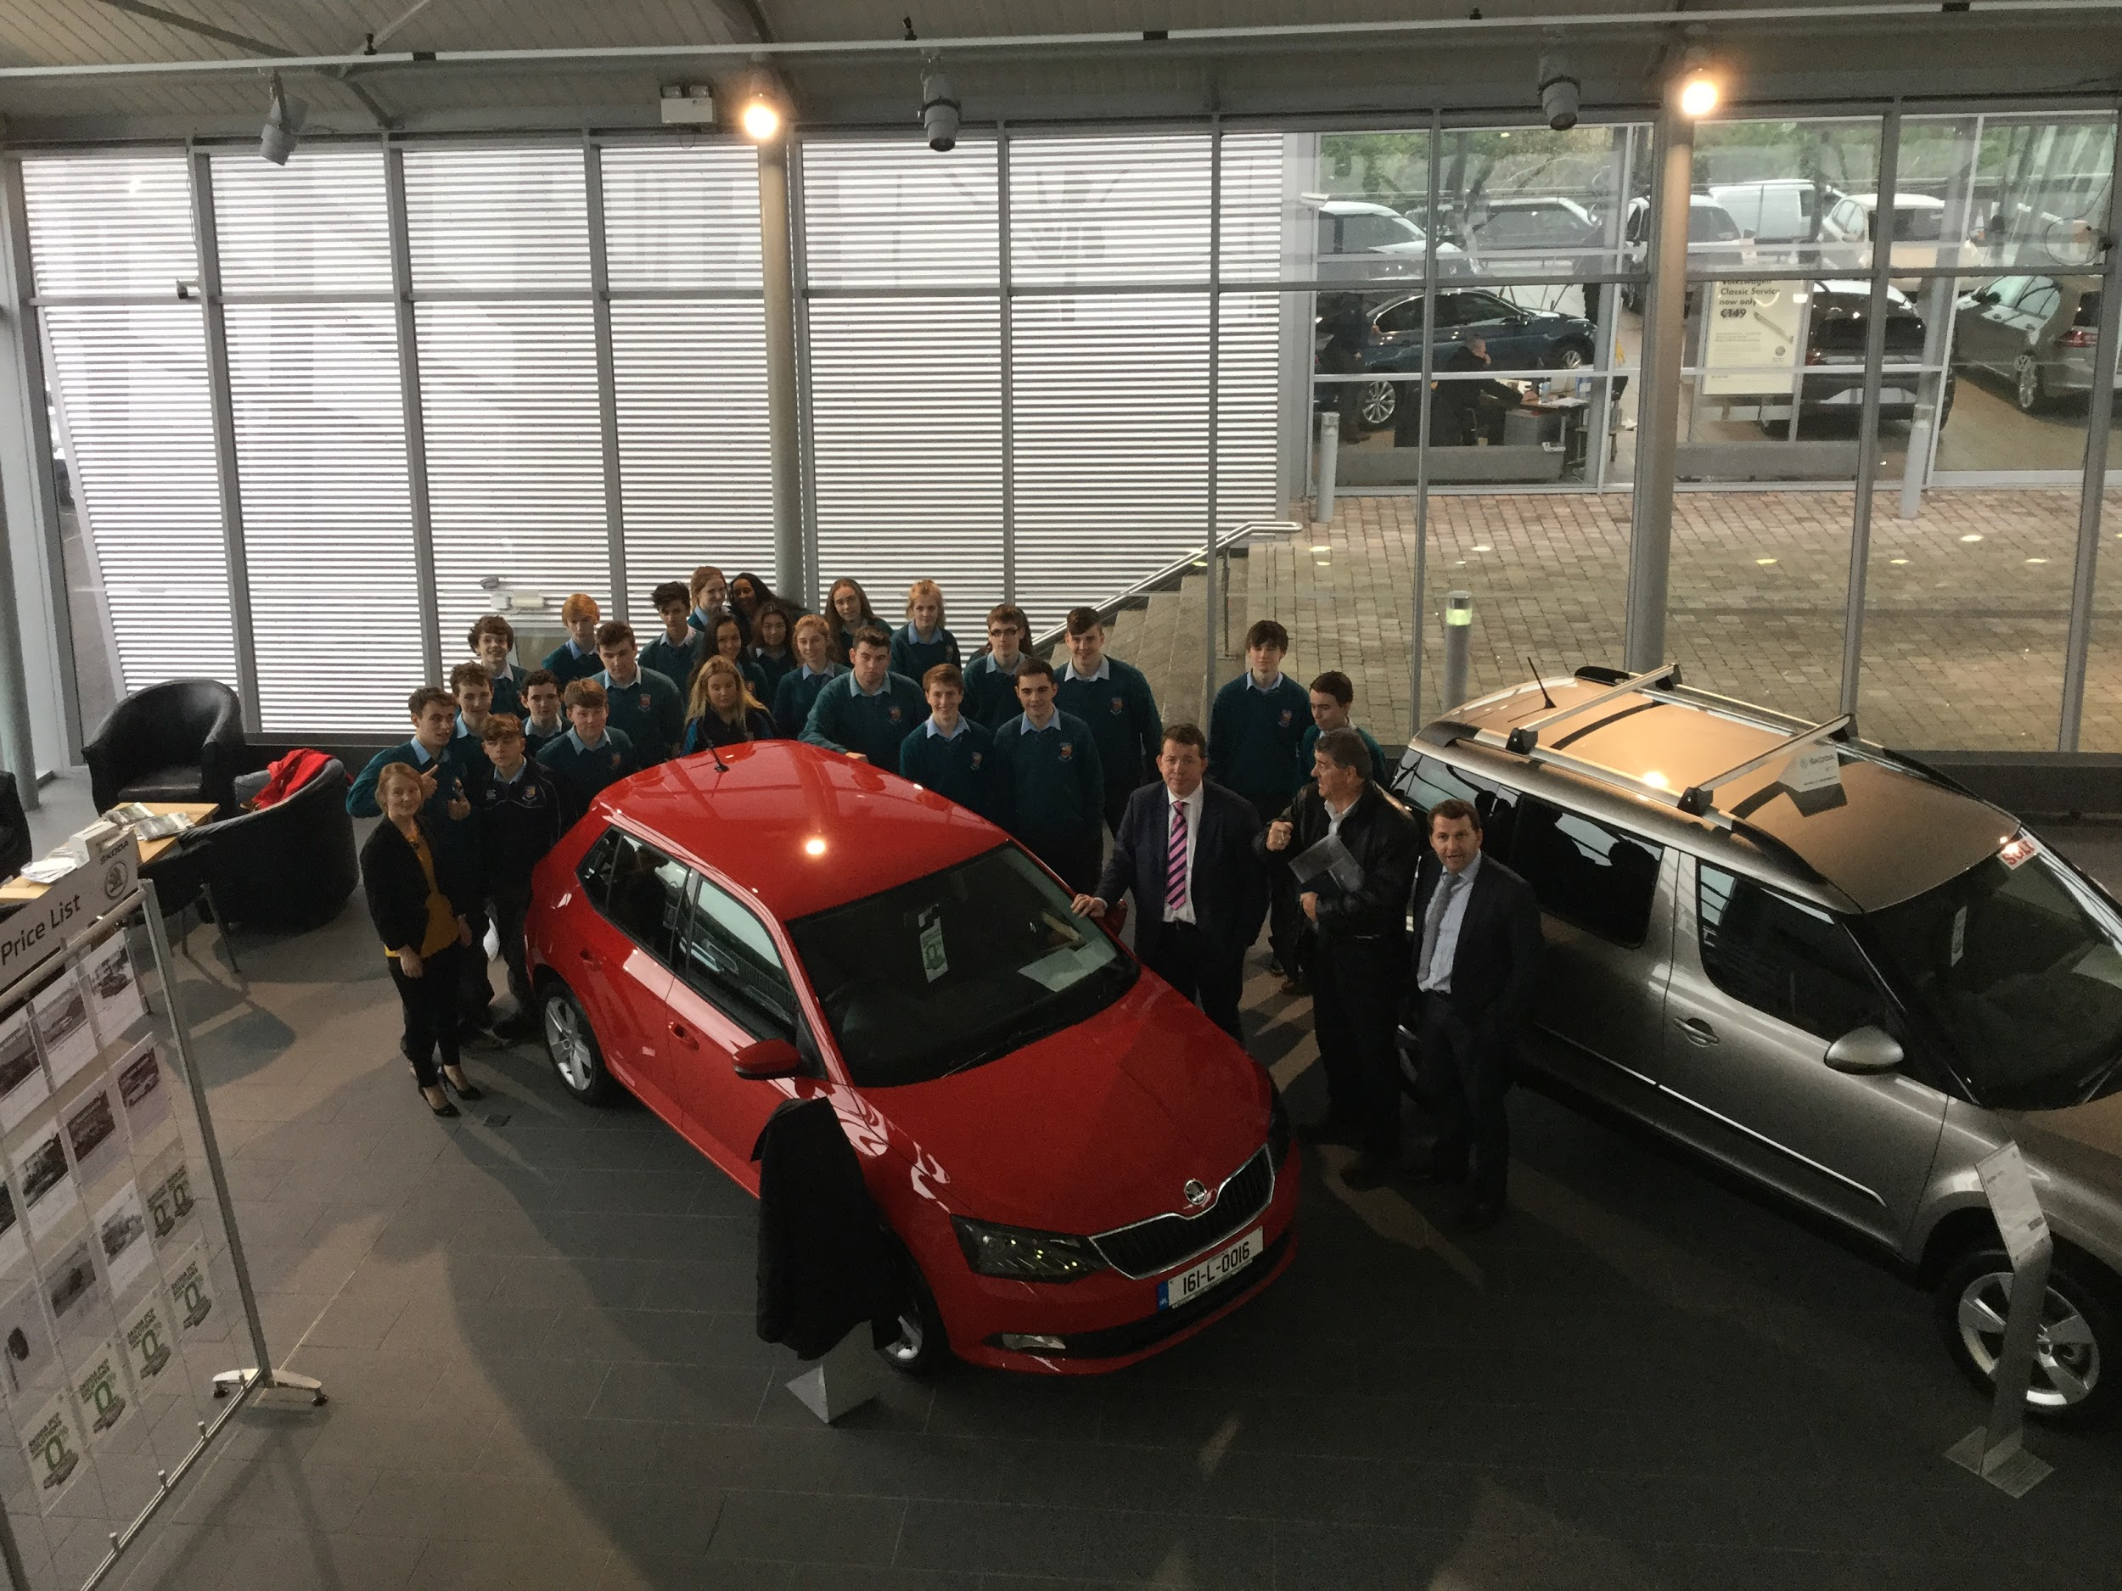
Transition Year Programme
Eirquest
Testing
Subject Option Fair
Guidance Class
Careers
Irish Hotel Federation Hospitality Course
Work Experience
Visiting Speakers

Slide 23
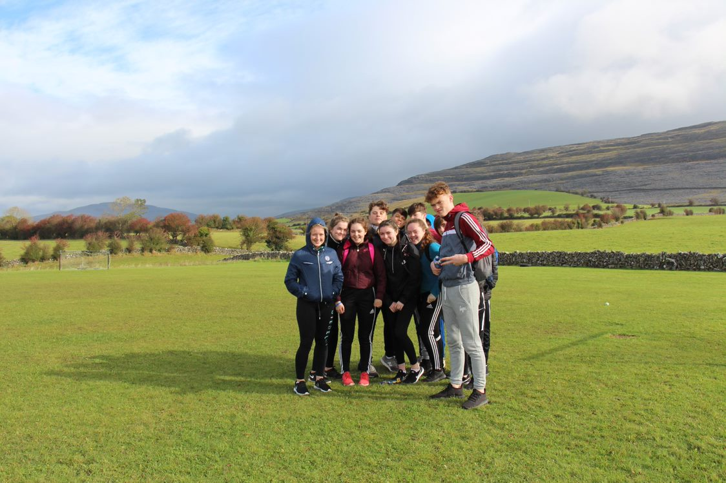
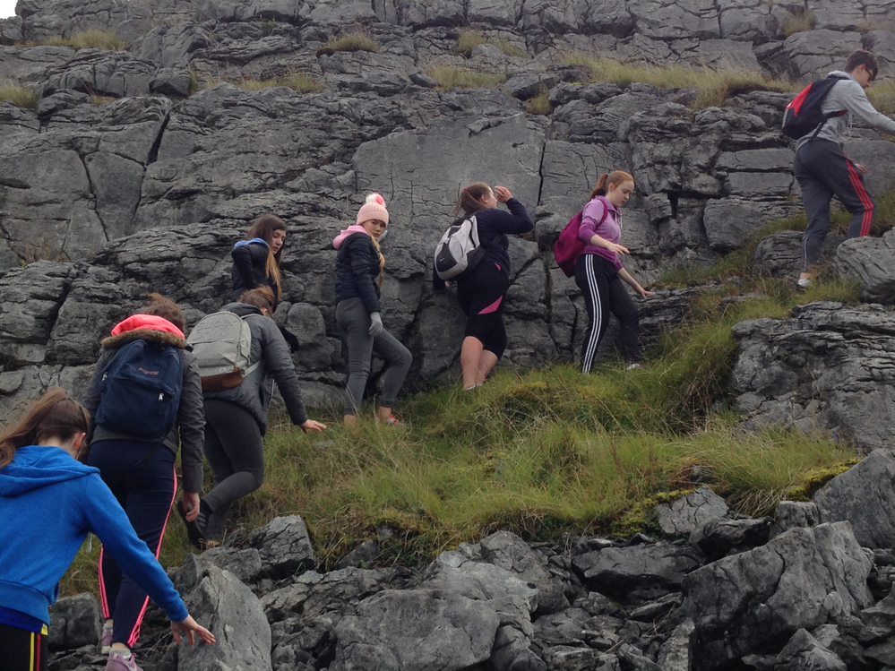
Transition Year Programme
Coaching
Fencing Lessons
S&C
Physical Education
Killary Outdoor ed. Centre
Ice-Skating
Paint-balling

Slide 24
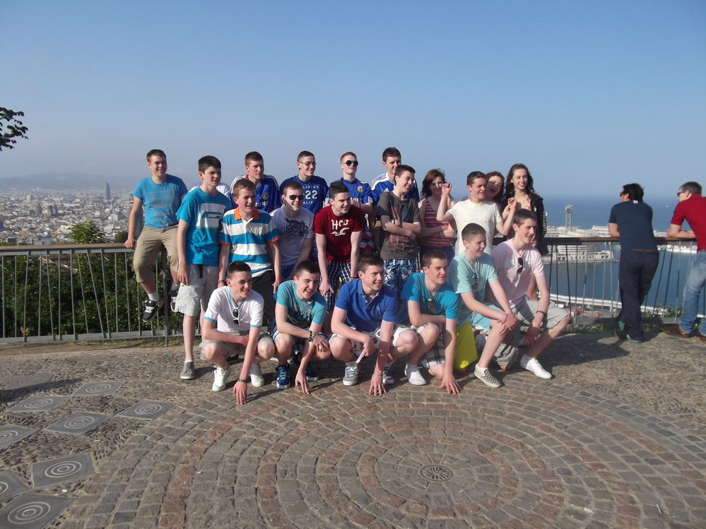
Transition Year Programme
European Parliament Ambassador School
French Exchange option
Barcelona Tour option
International Experience

Slide 25
A sample of the many other activities offered to students
Future Leaders | Music Generation Clare | Ice Skating | Mentoring 1st Year students
Get Go, Get Rowing | Royal College of Surgeons taster days | Animal Magic | Irish Heart Foundation
History Trip | Public Access to Law | Clare Sports Partnership | Dance Lessons
Fencing Lessons | Teen Conflict Management | IT for Senior Citizens Group | GAA Coaching Course
Bodhran-making course | Radio workshop | Shannon Foynes Competition | E-Scooter Training
Road Safety | EU Language Competition | EU Parliament Competition | Debating
RSA Roadshow | CPR | Burning House Film Course | Photography workshop

Slide 26
Transition Year Programme
E-Portfolios
Students complete an E-Portfolio using Microsoft Teams
Students will be trained on developing their reflective skills and encouraged to apply this to their learning in all subject areas.
In May students' showcase their portfolio and complete an interview based on the Portfolio

Slide 27
Transition Year Programme
Assessment
Students undertake continuous assessment including…
Group work, Presentations, written exam, etc
Participation in class, project work, social work, group work, work experience etc.
Subject Reports sent home at Christmas & Summer
End of year interview & student showcase
Journals
Reflective log.
Review Class-twice weekly.
Useful in assessing the level of student participation/attendance in Transition Year.

Slide 28
Transition Year Programme
Certification
Students will earn credits in their subjects, E-Portfolio, community involvement, extra-curricular and from their end of year presentation/formal interview.
The following standards will apply for certification
Distinction 80-100%
Merit 60-79%
Participation Below 60%

Slide 29
Transition Year Programme
Be Open Minded
Role
of T.Y. Student
Have-a-go
Positive Attitude
Respect Others

Slide 30
Transition Year Programme
Application Form
Role
of Parents
Encourage
Support
Communicate

Slide 31
Transition Year Programme
The admissions criteria includes the following.
Students get an opportunity on the application form & at interview to state why they wish to do TY.
Suitability of Student for the programme is decided by the school management as outlined in the Transition Year enrolment policy.
Possible to run up to 3 classes of 24 students.
A shortlist may be created for any remaining applicants.

Slide 32
Transition Year Programme
Transition Year Fee Per Student: €400
Initial deposit of €200 due with acceptance of place on the course.
The balance of €200 is due before 1st September 2024
What does the fee cover?
Outdoor Education activities
First Aid Qualification
Industry Visits
Guest Speakers
Transport costs
ICDL Course
Driving Theory Qualification.
Most TY activities
Programmes
Workshops
Student Services

Slide 33
Transition Year Programme
Míle Buíochas
Contact: Tom.Quealy@stcaimins.ie
Tel: 061 364211

Slide 34
Application Process

Slide 35
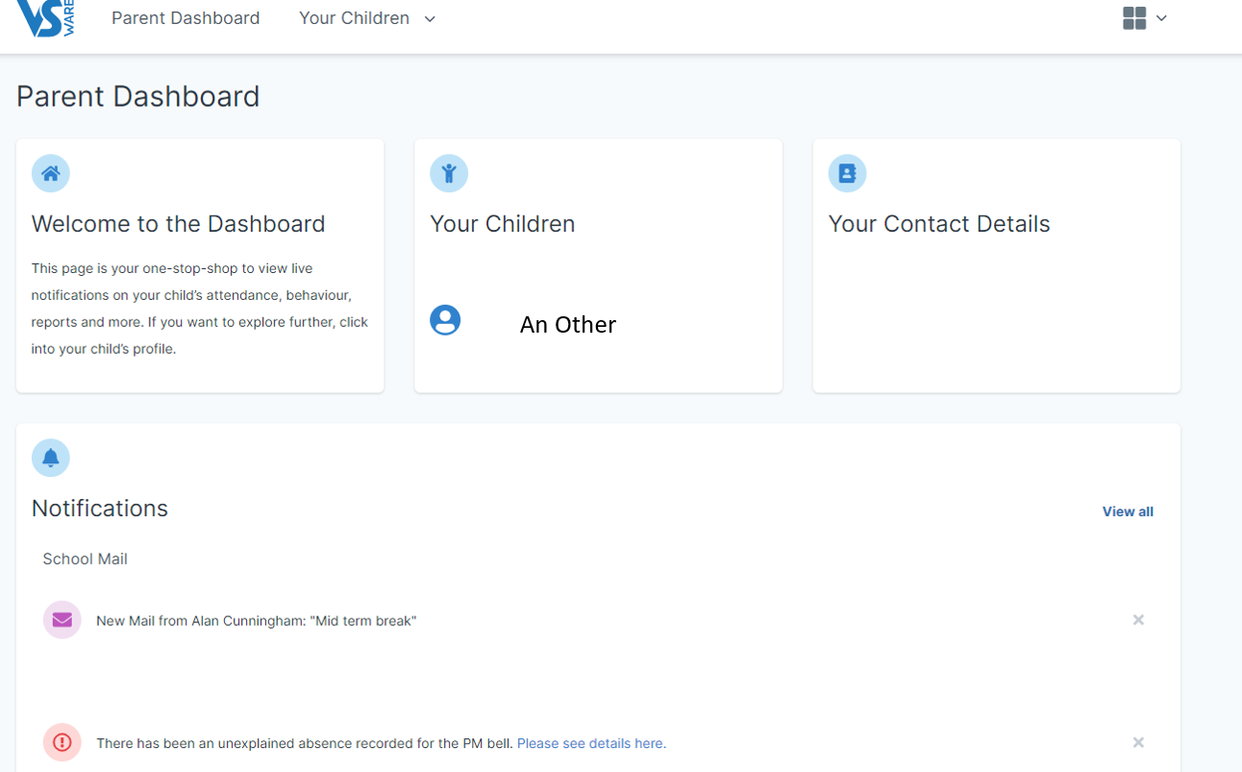

Slide 36
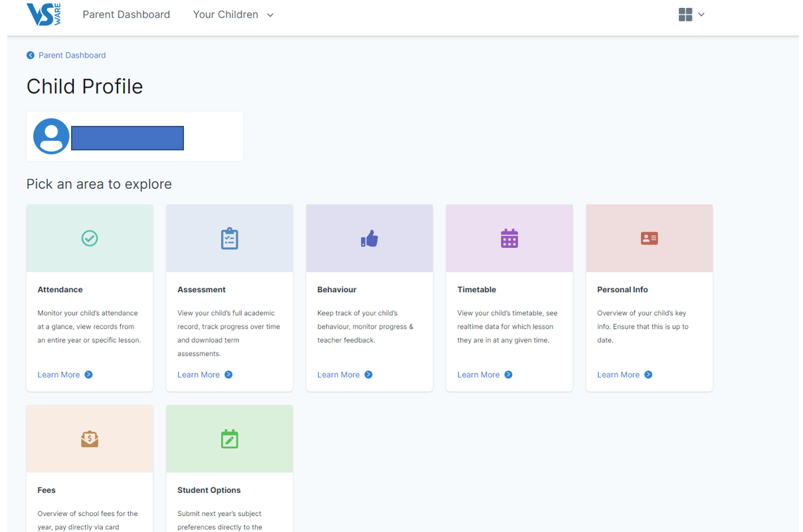

Slide 37
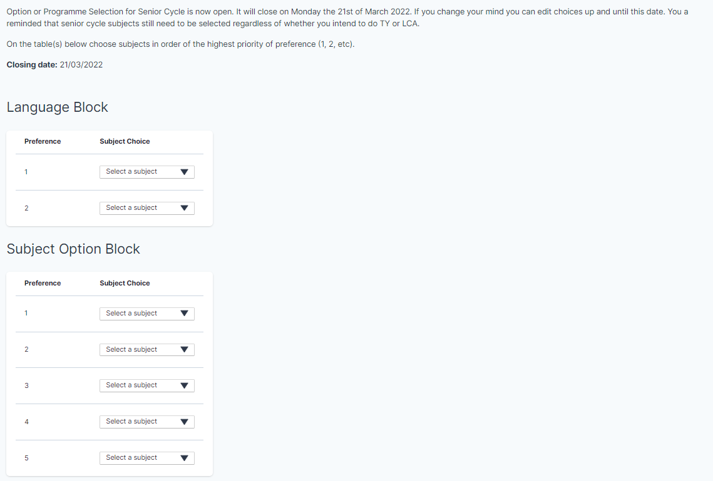

Slide 38
