Slide 1

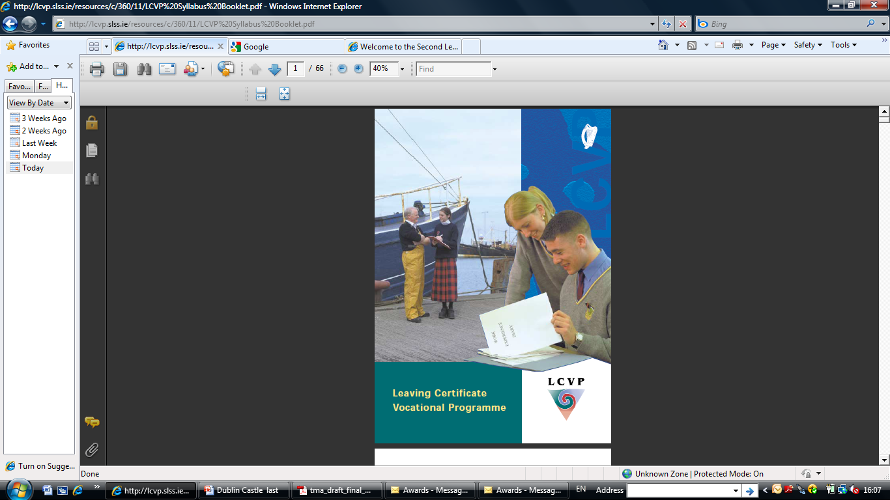
LCVP
Leaving Certificate PLUS

Slide 2
WHAT IS THE LCVP?
An Enhanced Leaving Certificate
  Strong Vocational Focus - VSGs
  Study of Link Modules
    Focus on Self-directed Learning
    Active teaching and learning methodologies
    Students develop a range of Key Transferable Skills

Slide 3
PROGRAMME REQUIREMENTS
2-year duration
Minimum 5 Leaving Certificate Subjects at Higher, Ordinary or Foundation level
  to include Irish
  to include 2 VSGs
Link Modules
Modern European Language
ICT

Slide 4
LCVP Structure
Link Modules
Vocational
Subject 2
Vocational
Subject 1
Irish
Modern European
Language
Other LC Subjects
Most LCVP Students take seven Leaving Certificate Subjects plus the Link Modules

Slide 5
LCVP Link Modules
Preparation for the World of Work
Enterprise Education

Slide 6
PREPARATION FOR THE WORLD OF WORK
Introduction to Working Life
Job-seeking Skills
Career Investigation
Work Placement

Slide 7
ENTERPRISE EDUCATION
Enterprise Skills
Local Business Enterprise
Local Voluntary Organisations / Community Enterprises
An Enterprise Activity

Slide 8
Typical LCVP Activities
Invited Visitors
Site Visit
Case Studies
Team Enterprises
Work Experience
Using Computers
Video Interviews

Slide 9
Transferable Skills
Team Working
Critical Thinking
Flexibility
Leadership
Basic Skills (incl. IT)
Motivation to Learn
Communication
Initiative & Enterprise
These skills are equally relevant to young people progressing to further study, working for themselves or going directly into employment

Slide 10
Purpose of the Link Modules
The Link Modules help you put theory into practice
Subjects being studied
Business
Community
Work / Career
LINK
MODULES

Slide 11
Link Modules Assessment
The Link Modules are assessed by written examination and portfolio

Slide 12
WRITTEN EXAMINATION
Section A - Audio-Visual Presentation
  Video sequence of an enterprise
Section B - Case Study
  Received 4 weeks in advance
Section C - General Questions
  Choice of 4 questions from 6

Slide 13
PORTFOLIO
CORE ITEMS:
Curriculum Vitae
Career Investigation
Summary Report
Enterprise/Action Plan

Slide 14
PORTFOLIO
OPTIONAL ITEMS:
Two out of Four
  Diary of Work Experience
  Enterprise Report
  Report on ‘My Own Place’
  Recorded Interview/Presentation

Slide 15
LCVP RECOGNITION
Entry to Universities and Institutes of Technology
Link Modules is a qualifying subject
for points

Slide 16
LINK MODULES
RESULTS
Distinction 80% - 100%
Merit 65% - 79%
Pass 50% - 64%

Slide 17
POINTS SCHEME
Grade Higher Grade Ordinary
H1 100
H2 88
H3 77
H4 66
H5 56 O1 56
H6 46 O2 46
H7 37 O3 37
H8 0 O4 28 O5 20 O6 20 O7 0
O8 0

